Slide 1
Why, when and how we should routinely be addressing patient heterogeneity in population-averaged economic models: an exploration of the known biases that may occur with naïve extrapolation using parametric survival analysis on RCT data
Xinglin Forum Presentation – 22 October 2019
Zhejiang University School of Medicine
Bojke, C., Howdon, D and Spencer K
Academic Unit of Health Economics
Leeds Institute of Health Sciences
Faculty of Medicine and Health
University of Leeds

Slide 2
Outline
The motivation and theoretical case for routinely incorporating heterogeneity even when data are generated by RCTs
A simulation exercise to test out theory
Application to real RCT data (prostate cancer patients)
Conclusions

Slide 3
Why?
The key role for economic evaluation is provide evidence-based outcomes in a recognised framework (Incremental Payer Costs per QALY) for counterfactual treatments across a population of patients
  Usually outcomes are (implicitly) averaged across a population although sometimes we might be interested in specific sub-groups.
However a population of patients rarely consists of a homogenous group of patients with consistent expectations of outcomes.
  Heterogeneity defined as observable or unobservable patient-level characteristics that have a systematic impact on the outcomes of interest.
  Focus in RCTs is not whether there are other factors affecting outcomes but rather whether they are well-balanced.

Slide 4
Why?
Many economic models, based on cohort markov models or decision trees may implicitly population-average
Is there a need to attempt to formally incorporate patient heterogeneity in simpler models, particularly where they may be based on RCTs and (justifiably) use simple markov models?
Yes – models will produce biased results under certain circumstances.
  And if so, how do we accommodate this both in estimating the impact and accommodating this in simple economic models

Slide 5
When … under what circumstances?
Perhaps a lot more frequently than you expect!
Suppose we need to choose between drug A & B for a population
We need evidence of effectiveness over
  The relevant patient population
  The relevant time period
Decision Context Box and Evidence Coverage
  We need to fill the box … with evidence or statistical modelling/extrapolation
Time →
Representativeness of sampled population

Slide 6
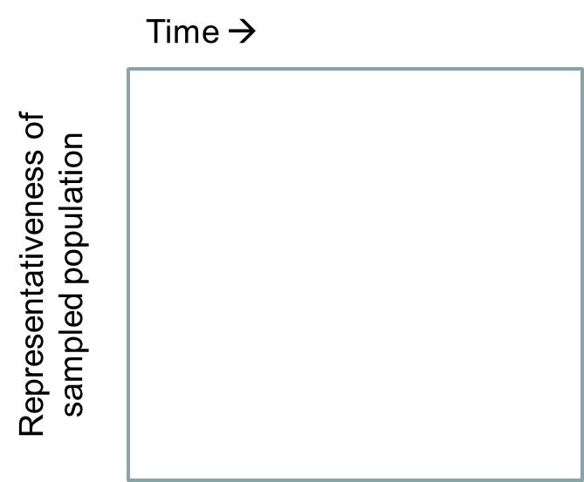
Data Coverage
We might be lucky and have a trial data provides all relevant evidence for relative effectiveness across time and population
In which case we can use very simple statistical methods – no need for any econometrics or more sophisticated model
‘Implicit’ population averaging okay
Trial Data

Slide 7
Usually …
In most cases we get this
In which case it is well known that we need to extrapolate across time – often using fairly complex ‘survival’ models
Representativeness of trial to treatment population not usually formally modelled
Time →
Trial Data
‘Modelled’ Survival Data
Representativeness of sampled population
And this bit often just gets ignored! (homogenous population assumed)

Slide 8
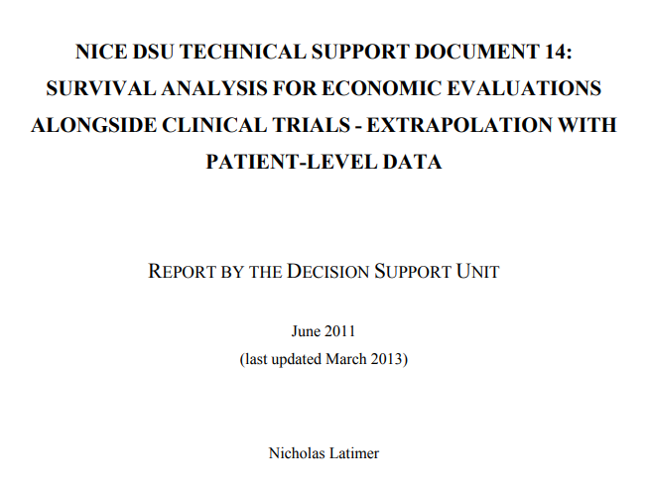
Survival Analysis
Survival analysis models use observed data to do two things
  Understand the impact of different drugs
  Model natural risk over time beyond that observed (known as the hazard)
Clear guidance on how to conduct survival analysis
But no mention on any need/methods to accommodate patient differences / heterogeneity
“Generally it is not necessary to include covariates in survival modelling in the context of an RCT as it would be expected that any important covariates would be balanced through the process of randomisation.”

Slide 9
Is this an issue?
In this application the modelled survival data for lung cancer patients are clearly incompatible with registry data
Industry quotes DSU about reasons the ignore heterogeneity
Explore more complex methods of splicing together different hazard functions over time
But is there a simpler explanation, are they right to ignore heterogeneity?

Slide 10

Why we can’t ignore heterogeneity : part 1
This is what an RCT allows you to assume
 | Omitted Patient Characteristics Uncorrelated with Treatment | Omitted Patient Characteristics Correlated with Treatment
Simple linear model of ‘no effect’ analysis | Unbiased | Biased
Complex (non-linear) models like *all* survival models | Biased (Attenuated) | Biased
But unless your trial is of sufficient duration for the decision context and you therefore need to use survival models … you will be here

Slide 11
Why we can’t ignore heterogeneity : part 2
In models which employ survival analysis it is well known that correctly modelling the hazard over time is often of vital importance.
Regression models employed to make that extrapolation
  Often when RCTs are used.
A lot of time and effort has gone into optimal model choice in terms of best-fitting over observed period & clinical plausibility
But virtually nothing on the impact of heterogeneity.

Slide 12
Negative Duration Dependence
It will probably get the dynamics of underlying risk over time incorrect
Failure to control for unobserved variables leads to a bias toward negative duration dependence i.e. it can lead to an estimated hazard that declines more steeply, or rises more slowly than the true hazard. Blossfeld & Hamerle 1989
h(t)
censoring
h₁(t)
Population averaged hazard
h₂(t)
Estimated hazard with censoring ?
time

Slide 13
Individual level regression models vs population averaging
We most often are actually interested in the population-averaged hazard, but the models we employ are based techniques which take an individual perspective
It might not matter - If the model period <= trial period then it doesn’t matter – just use KM
Or, we might get lucky … the distribution of underlying hazards over the population and how it changes over time might well be accurately captures by an individual level model which (incorrectly) assumes an individual specifc hazard
  Otherwise we have to be lucky conditions are right for individual level model to act as a population averaged model
  And also hope it doesn’t fail the clinical plausibility test

Slide 14
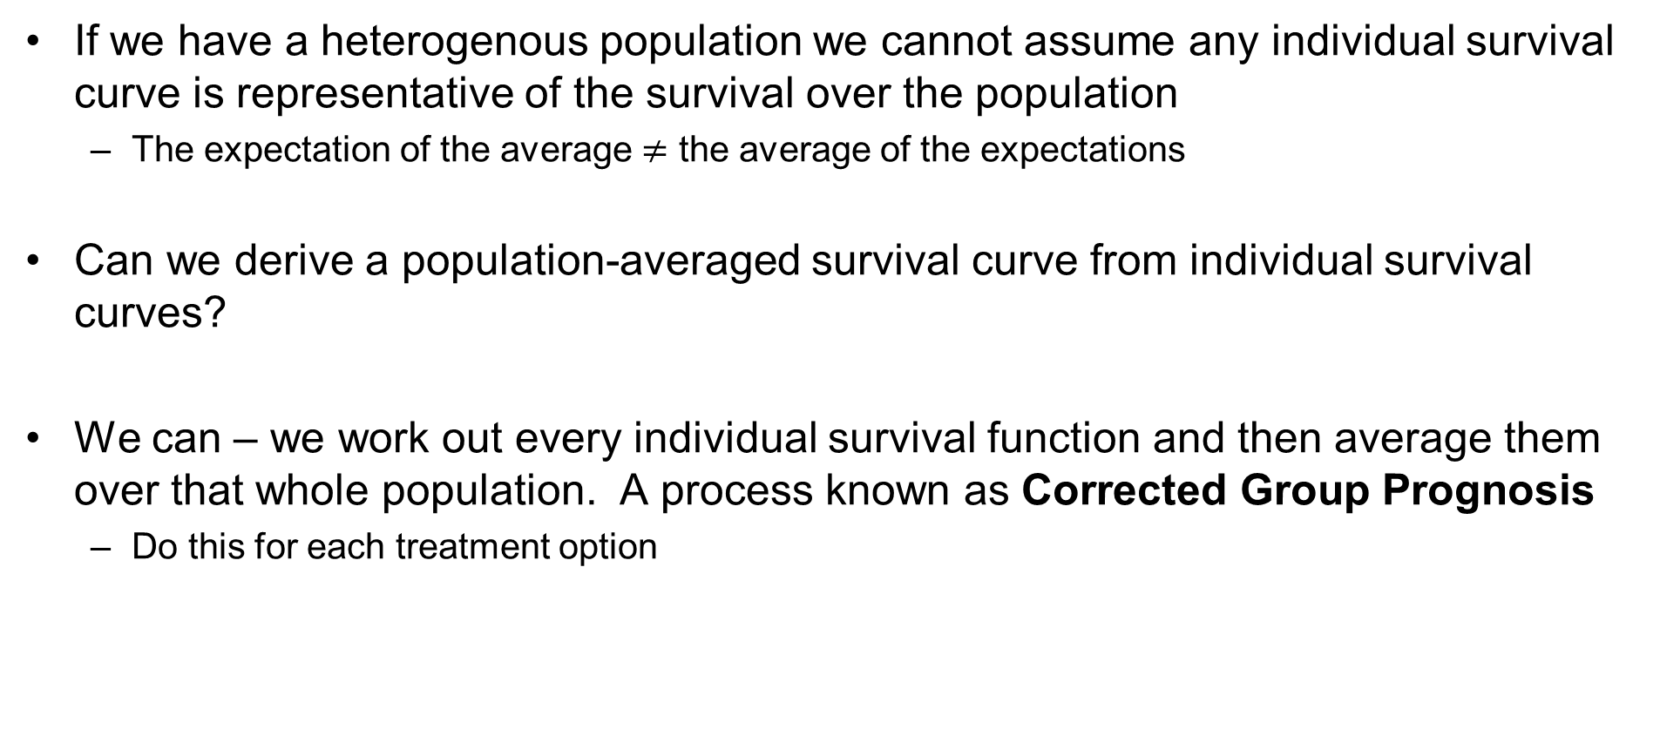
Constructing a P-A survival curve
If we have a heterogenous population we cannot assume any individual survival curve is representative of the survival over the population
  The expectation of the average $≠$ the average of the expectations
Can we derive a population-averaged survival curve from individual survival curves?
We can – we work out every individual survival function and then average them over that whole population. A process known as Corrected Group Prognosis
  Do this for each treatment option

Slide 15
A Philosophical Divide?
Scientific inquiry has focussed on isolating the impact of a specific explanatory variable/technology free from the impact of nuisance parameters and testing whether any effect is statistically significant or not.
  Without modelling the survival function, negative dependence duration is never an issue
  In some cases attenuation bias might be an issue
Decision science should focus on quantifying the practical impact of a technology applied across the relevant population including the mitigating impact of patient heterogeneity
  Which may require modelling of the survival function and therefore negative dependence duration does become an issue.
All of the issues so far discussed are known in the statistical literature but have not transferred across to HE possibly because the impact is limited when solely looking for statistical inference

Slide 16
Simulation example (in progress)
Simulate an RCT with 200 patients & 10,000 simulations each with underlying heterogeneity drawn from a Gamma distribution (alpha = 1 beta = 2)
Exponential model assume for each patient lambda = -7.5
Individual heterogeneity impat (lhr) = 1
Patients randomised to treatment which has a consistent impact (lhr) =-0.5
Survsim Stata command used to simulate survival time
We apply a censoring time of 50 days for the analysis though we can plot the KM to see the true population survival time.
Apply DSU approach ignoring heterogeneity – produce S(t)
Include heterogeneity and model Corrected Group Prognosis S(t)

Slide 17
Example Output
KM observed up to 50 days
Green line shows naïve best fit model
Blue line shows CGP method applied to trt cohort
Can use area between estimated curves and true KM as measure of best fit

Slide 18
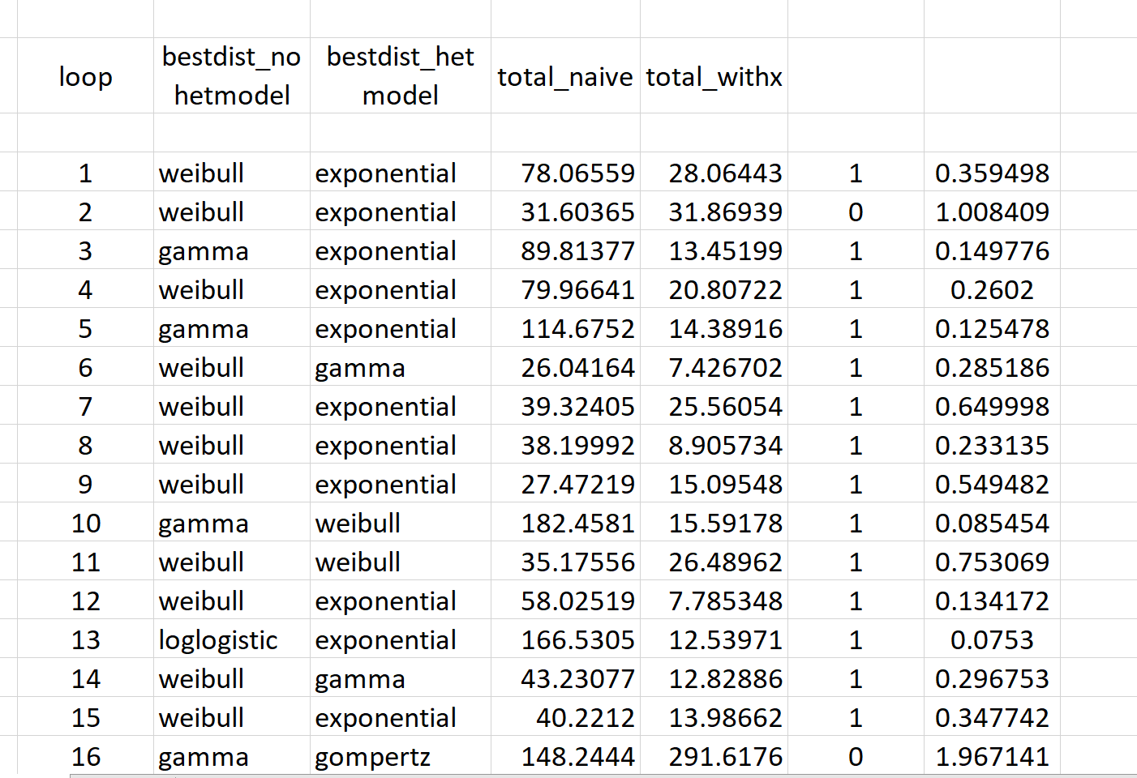
Initial results
Simulation model in line with theoretical expectations
Naïve model never has exponential as best fit
CGP best fit 85% of the time
Mean reduction in absolute error of 40%
Median reduction in abs error of 75%
Using BIC rather than AIC improves performance further
If we put censoring at 365 days virtually no difference

Slide 19
When regression gets it incorrect
Incorrect hazard chosen – very poor fit

Slide 20
What is the issue?
Incorrect choice of hazard function yields catastrophic failure
More likely under model which incorporates heterogeneity
Could we use clinical expertise to rule out ‘extreme’ distributions?
If we impose Weibull dist onto heterogenous model we always get better fit

Slide 21
Real World Example
Dutch Bone Metastasis Study (DBMS)
1,171 Patients in the Netherlands with painful bone metastasis on palliative care over the period 1996-1998
Treatment choices were different types and durations of radiotherapy treatment which was not expected to have an impact on survival
We focus on 267 patients with prostate cancer

Slide 22
Prostate Cancer in DBMS
We have complete survival histories for the 267 patients
But like with the simulation model we artificially censor, this time at 200 days, and use the modelling techniques to compare survival prediction
Unlike with the survival model:
  We have no idea what the ‘true’ hazard is
  We have a selection of covariates in which to estimate the impact of observable heterogeneity

Slide 23
Model performance on DBMS data
Explanatory variables chosen with clinician: age, age-sqd, WHO performance status, EQ-5-3L dimension levels and extent of metastatic spread
Best-fitting model chosen on basis of BIC
Log-Normal hazard selected in both cases
  Fits with literature too
Heterogeneity controlled model clear winner.
  Error is more than 50% reduced.

Slide 24
What if we have the ‘wrong’ regressors?
We may not always know which regressors to include
Are the results sensitive to covariate choice?
Drop the metastatic spread dummy variable
BIC selection on heterogeneous model now suggests Gamma distribution
Naïve model now best fit
Incorrect regressors → inappropriate hazard

Slide 25
Is there a risk averse method
What if impose the selection of hazard as predicted by naïve model?
But still use the incorrect explanatory variables
Heterogeneous model becomes best fit again
It is not as good as heterogeneous model with correct regressors but might represent a risk-averse ‘safe’ method

Slide 26
Conclusions
There is a methodology issue in survival analysis that is well-established (if not particularly well-known) in the statistical literature for around 40 years that has not transferred to the health economics literature
  This may be due to statisticians focussing on narrow hypothesis testing and, as a result, health economists not being completely aware of the limitations of the models when extrapolating
This issue occurs whether the data come from RCTs or not
  Seems particularly an issue in lung cancer and wound healing
Potential solutions to address this have also been known in the statistical literature for a similar period
  E.g. Corrected Group Prognosis

Slide 27
Conclusions
However via simulation and real world data we have shown that resolving the issue may not be straight forward.
The obvious solution of including observed covariates to accommodate heterogeneity usually improves fit over the extrapolated period but does run a risk of getting it horribly wrong.
  In all cases it is due to the selection of an inappropriate hazard function.
Can we adopt principles to avoid catastrophic errors?
  Clinical plausibility should always be checked, don’t let BIC solely determine model choice
  Adoption of hazard distribution as implied by naïve model

Slide 28
Additional complexities?
What if heterogeneity is not just limited to survival?
  Don’t think it makes sense to use CGP method
  Need to capture heterogeneity jointly across outcomes
  Would suggest splitting patient population into classes and running cohort model per class and producing weighted-average evaluation results
What if heterogeneity is unobserved
  Trials with several follow-up points permit random-effect models
  These can be used to produce Empirical Bayesian Estimates of individual heterogeneity – we can use these to classify patients

Slide 29
Prof Chris Bojke - c.bojke@leeds.ac.uk
Faculty of Medicine and Health
University of Leeds
Level 10 Worsley Building
Clarendon Way
Leeds, United Kingdom
LS2 9NL www.leeds.ac.uk/lihs

