Slide 1
Integrating health economics into the development and evaluation pipeline for medical tests
Dr. Bethany Shinkins
Associate Professor
Test Evaluation Group Lead
Academic Unit of Health Economics

Slide 2

In Vitro Diagnostic MICs
Newcastle upon Tyne NHS Foundation Trust
Cancer, Cardiovascular disease and stroke,
Genetics, Infection, Liver disease, Musculoskeletal disease, Respiratory, Transplantation.
Leeds Teaching Hospitals NHS Trust
Cancer, Infection, Musculoskeletal, Colorectal & Urological Diseases.
Oxford Health NHS Foundation Trust
Primary care IVDs: Horizon scanning and rapid reviews to identify new and emerging IVDs
Imperial College
Healthcare NHS Trust
Cancer, CVD,
Gut health, Infectious diseases,
Metabolic medicine, Primary Care,
Respiratory diseases.

Slide 3



In Vitro Diagnostic MICs
1st Valley of Death
MICs
Capacity and Resource
Biomedical Research
New IVD Development & Market Approval
Clinical Practice & Adoption
Translational Continuum
(adapted from www.cihr-irsc.gc.ca)
Facilitate the generation of evidence on:
  clinical validity
  clinical utility
  cost effectiveness
  care pathway benefits
  …of in vitro diagnostic tests (IVDs) – excludes imaging
  CATALYSE, COLLABORATE, INNOVATE METHODOLOGY

Slide 4
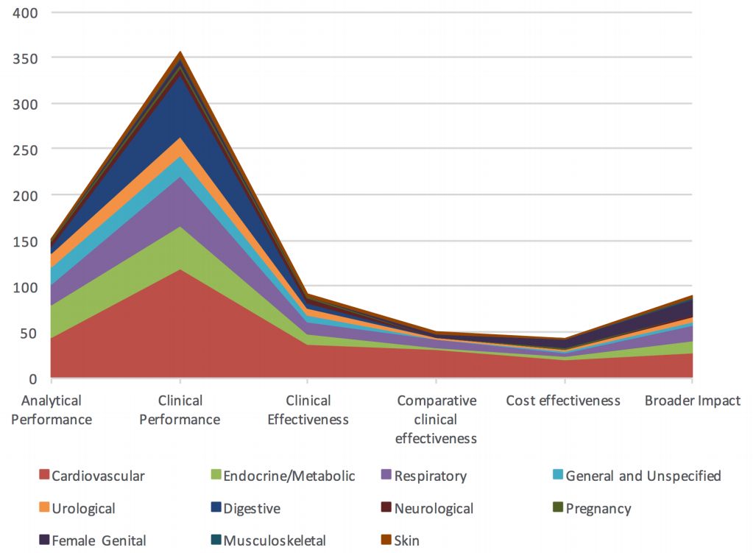
Evidence Gaps
Clinical accuracy
71.2%
Analytical Validity
30.4%
Cost-effectiveness
8%
Clinical utility
10.0%
Broader Impact ~18%
Image Credit: Verbakel, Shinkins et al, BMJ Open;7:e015760.

Slide 5
Evidence Pipeline

Slide 6
Early Economic Modelling
Assess potential cost-effectiveness of new diagnostics in the very early stages of development
Inform Stop-Go Decisions
Guide Development
Prioritise Evidence Generation

Slide 7
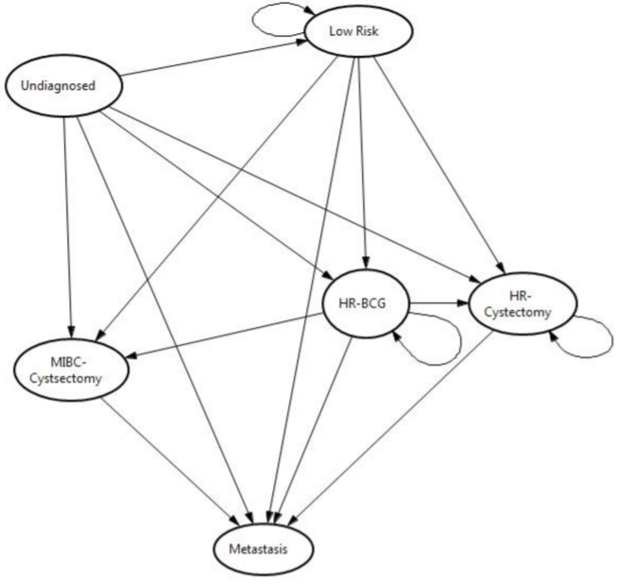
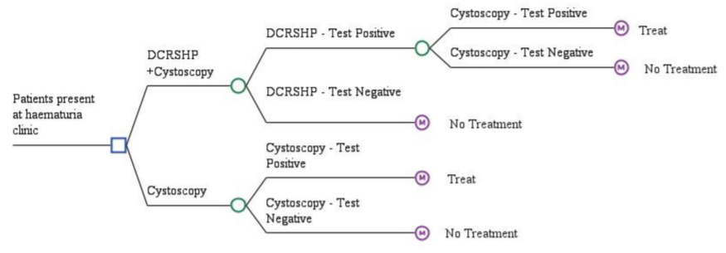
Decision Analytic Modelling
Combines evidence from multiple sources, making best use of an often-limited evidence base
Extensive sensitivity analyses used to characterise uncertainty
Sutton et al. (2018) PlosOne.

Slide 8
Value of Information
A decision in the face of uncertainty
... Risks an incorrect/suboptimal decision
Consequence of incorrect decision =
Less health or more cost
Research reduces uncertainty therefore has value
VoI
Probability of incorrect decision
Consequences of incorrect decision
=
x
= expected opportunity cost

Slide 9
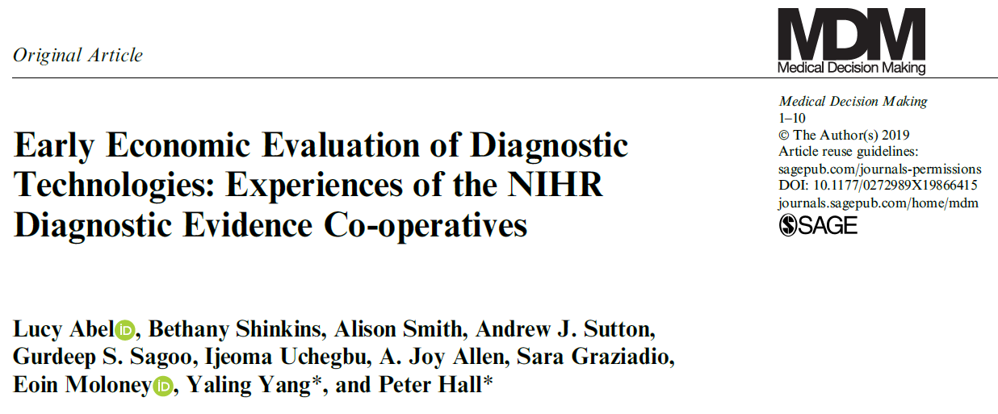
Early Economic Modelling

Slide 10
Evidence Pipeline

Slide 11
Early Economic Modelling
Assess potential cost-effectiveness of new diagnostics in the very early stages of development
Inform Stop-Go Decisions
Guide Development
Prioritise Evidence Generation

Slide 12
Unmet Clinical Need
Tests often begin as laboratory discoveries
  shoe-horned into clinical practice
Can we work backwards and use early economic modelling to identify minimal test characteristics to meet an unmet clinical need?
Mechanism for ‘clinical pull’?

Slide 13
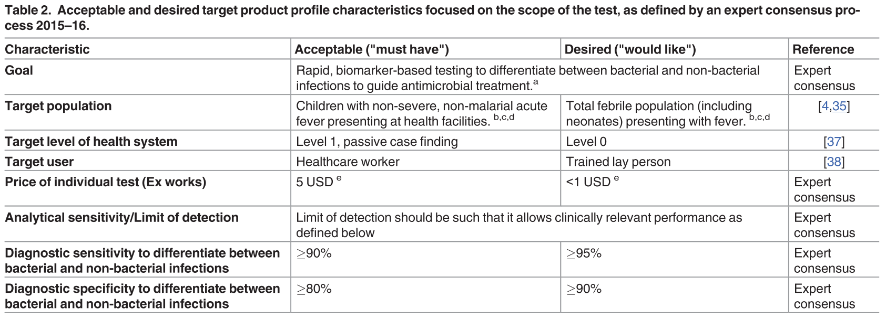
Target Product Profiles
Characteristics reported in TPPs are usually based on literature findings and consultation with experts
Currently no formal guidance for developing TPPs for tests
Source: Dittrich S, et al. Target Product Profile for a diagnostic assay to differentiate between bacterial and non-bacterial infections to guide antimicrobials use in resource-limited settings: An expert consensus.

Slide 14
Methodology Review
Completed a systematic review of TPPs for tests
Common methods framework identified
Scoping
Landscape analysis
Literature review
Drafting
Draft TPP
Rounds of revision
Consensus Building
Delphi-like surveys
Consensus meeting
Define decision problem
Paola Cocco

Slide 15
Room for Improvement
Some limitations to current methods for developing TPPs
    Overlook clinical utility and cost-effectiveness
    Primarily driven by expert opinion
    Poor transparency in reporting

Slide 16
Complementary Methodology
Early Economic Modelling
Formal care pathway mapping and comparison: full understanding of mechanisms by which a test impacts patient health
Can provide quantitative ranges for some test characteristics based on clinical- and cost-effectiveness
Characterisation of uncertainty
Target Product Profiles
Comprehensive understanding of unmet clinical need: multiple stakeholder inputs
Provides information on what would be clinically acceptability/feasible
Informs desirable test characteristics that can’t be modelled e.g. preferred sampling technique

Slide 17
Ongoing Work
We have two projects where we are combining standard TPP methodology with early economic modelling to produce comprehensive TPPs for ‘fit for purpose’ tests
C.Diff
Lung Cancer Screening

Slide 18
Evidence Pipeline

Slide 19
OPTIMA
Chemotherapy for ER-positive HER2-negative, lymph node-positive primary breast cancer:
After curative surgical resection
Aims to reduce risk of cancer recurrence
Problem: Not all patients benefit / risk of harm
Precision medicine
→ select tumours which are biologically sensitive
Funding acknowledgement: Optima Prelim (10/34/01) and OPTIMA (10/34/501) are both funded by NIHR HTA.

Slide 20
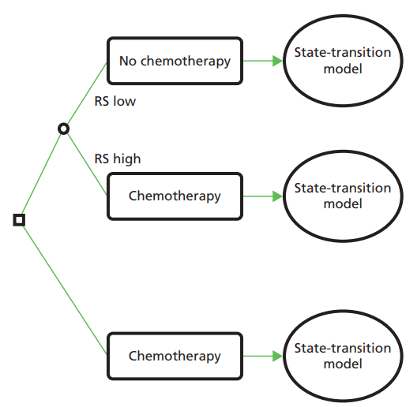
Early Economic Evaluation
Proportion assigned to high- and low-risk groups and recurrence estimates from SWOG88-14 Oncotype DX analysis

Slide 21
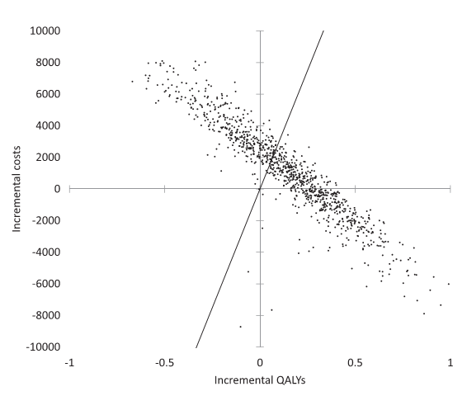
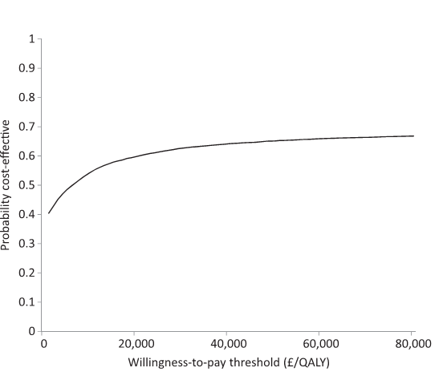
Results
  ICER = £5,529 per QALY
  95% CI <£0 - >£500,000
  Probability cost-effective = 61% (threshold £30k/QALY)
Hall et al. J Natl Cancer Inst 2012;104:56–66

Slide 22
Value of Information Analysis
*Population EVPPI calculated over 10 years, WTP threshold £20,000 per QALY

Slide 23
Evaluation Pipeline
Analytical validity
Clinical validity
Evidence synthesis
Economic Model
VoI analysis
STOP/GO

Slide 24
Evaluation Pipeline
Analytical validity
Testing logistics
Clinical validity
Patient acceptability
Evidence synthesis
Economic Model
Randomised feasibility study
Economic Model
Clinician acceptability
VoI analysis
Research design
Test selection
VoI analysis
STOP/GO

Slide 25
Optima Prelim: Feasibility Study
  Establish acceptability of randomisation
  Evaluate the comparative performance of multi-parameter tests
  Provide UK data on % high- versus low-risk recurrence
  Cost and QoL for chemo versus no chemo comparison
  Real world data on costs of cancer recurrence
  → Facilitate Value of Information Analysis to help decide whether RCT appropriate

Slide 26
Value of Information Analysis
EVPPI for 5 year recurrence-free survival

Slide 27
Evaluation Pipeline
Analytical validity
Testing logistics
Clinical validity
Patient acceptability
Evidence synthesis
Economic Model
Randomised feasibility study
Economic Model
Clinician acceptability
VoI analysis
Research design
Test selection
VoI analysis
STOP/GO
STOP/GO

Slide 28
Evaluation Pipeline
Analytical validity
Testing logistics
Clinical validity
Patient acceptability
Evidence synthesis
Economic Model
Randomised feasibility study
Economic Model
Full RCT
Clinician acceptability
VoI analysis
Research design
Test selection
VoI analysis
Research design
STOP/GO
STOP/GO

Slide 29
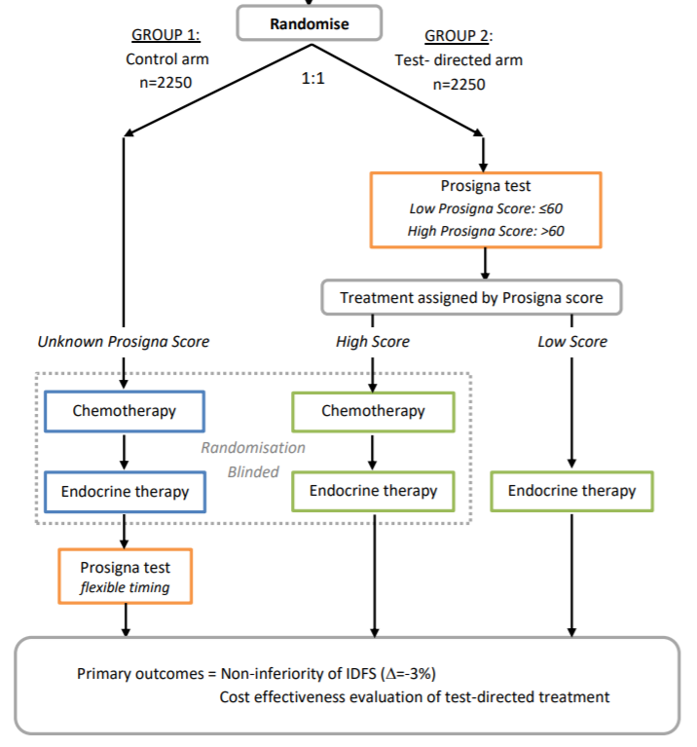
OPTIMA Trial
A 200-patient extension phase was built into the design of OPTIMA prelim to allow a smooth roll over
Cost and QALY primary outcomes in the trial
Main part of the trial underway
  1927 patients recruited to date
Funding acknowledgement: Optima Prelim (10/34/01) and OPTIMA (10/34/501) are both funded by NIHR HTA.

Slide 30


Slide 31
Evidence Pipeline

Slide 32
RCTs of Tests
Test-treatment RCTs are rare
  Average of 37 published per year (Ferrante di Ruffano, 2012)
  Very low compared to 21,949 per year for all RCTs
Economic and health benefits often do not emerge until long after a test has been carried out
Changes to patient outcomes can be difficult to capture
  Beyond the length of a study
Health economists have to use lower grade evidence to evaluate tests as it is unlikely that RCTs exist in many fields

Slide 33
Improving HTA Methodology
A linked evidence approach is often adopted for cost-effectiveness evaluations of tests
Review of evidence synthesis methods used to inform model-based cost-effectiveness evaluations of tests
Heavy emphasis on diagnostic accuracy, less so on treatment efficacy
Minimal sensitivity analyses around the assumption of ‘test-directed’ decision making
Shinkins, Yang, Abel, Fashawe (2017) Evidence synthesis to inform model-based cost-effectiveness evaluations of diagnostic tests: a methodological review of health technology assessments. BMC Med Res Meth

Slide 34
Over to you
Let’s assume we have a new test which has been shown to be highly accurate
How might this test still fail to improve patient outcomes?

Slide 35
Some examples
Inadequate infrastructure
Low patient acceptability of test/treatment
No treatment available
Test not adopted/resistance to change
Skill mix/expertise
Repercussions of misclassifications
Test result too late to impact on decision-making
Anxiety due to diagnostic label
Cost of test/treatment
Non-compliance to treatment
Overdiagnosis and incidentalomas (associated costs)
‘Real-world’ imprecision
Mechanisms for reimbursement/unwillingness to move money between budgets
Result ignored…no impact on management decision
Implemented in different setting/patient population to the ones evaluated

Slide 36

Real-World Decision Making
Possible to do smaller studies that collect data on real-world decision making
Prolaris (Myriad) stratifies patients with low/intermediate risk prostate cancer based on disease aggressiveness and mortality risk
Built an early economic model using routinely collected data to estimate expected changes in treatment decisions
Now running a study assessing how the Prolaris (Myriad) test is used in real-world decision making
Gurdeep Sagoo

Slide 37
Review of EE Quality
Developed a quality appraisal check-list for model-based cost-effectiveness evaluations of diagnostic tests
  Used to appraise and review HTAs in UK
Results were generally very positive
Some areas for improvement:
  Assumption of independence of tests in sequence
  Minimal model validation
  Poor justification of comparators
Yang, Abel, Buchanan, Fanshawe, Shinkins (2019) Use of Decision Modelling in Economic Evaluations of Diagnostic Tests: An Appraisal and Review of Health Technology Assessments in the UK. PharmacoEconomics-Open.

Slide 38

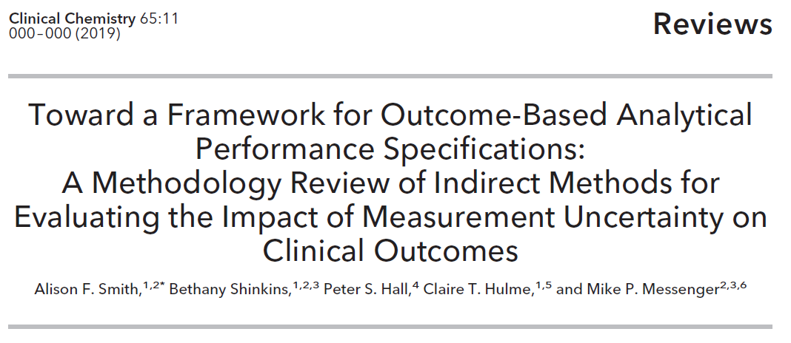
Analytical Performance Goals
Developed a framework for assessing the impact of test measurement uncertainty on clinical- and cost-effectiveness outcomes
Alison Smith

Slide 39
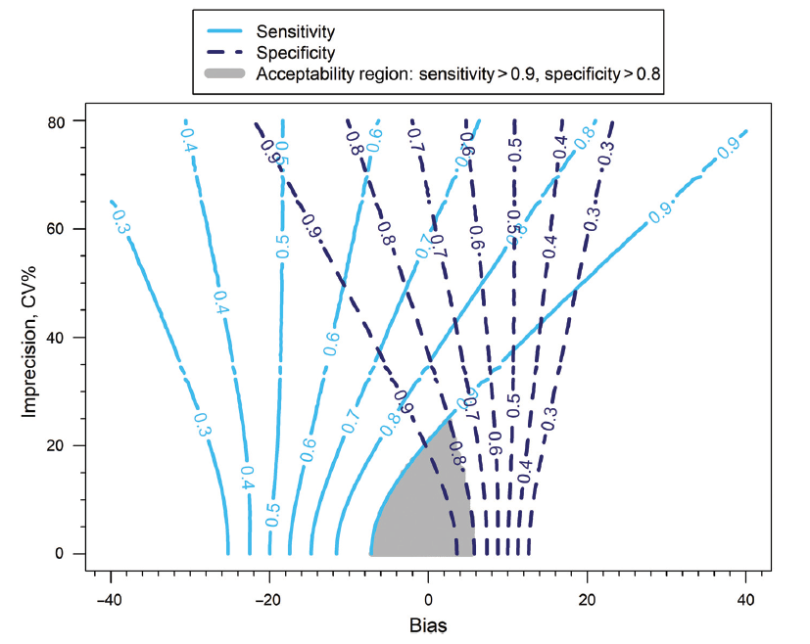
Analytical Performance Goals
Allows accurate assessment of the expected performance of tests within HTAs
Enables laboratory specifications for the necessary performance of tests to be set

Slide 40
Evidence Pipeline

Slide 41
CCG Decision-Making
Previous work with CCGs
  Discussed barriers to decision-making regarding IVDs
  Observed decision-making in action
Key findings
  Struggle to translate the outputs of NICE EE in the context of restricted local budgets and limited capacity/infrastructure
  Problematic for interventions (like many tests) where substantial upfront investment is often required but the benefits/cost-savings are not realised for years to come

Slide 42
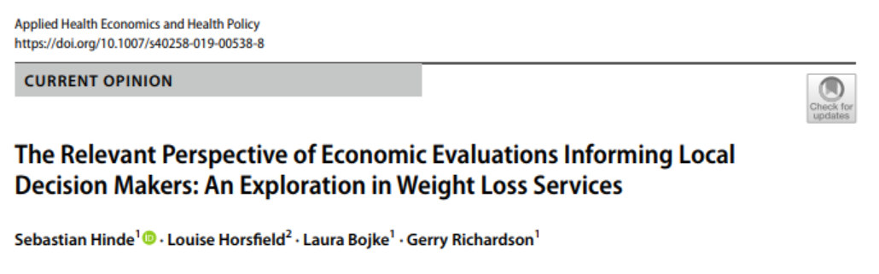
Recent Findings
Cost-Effectiveness Threshold
Scope of Costs Included
Valuation of future costs and benefits
Exceeding Budget and Uncertainty

Slide 43
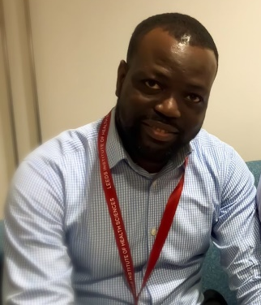
Supporting Decision-Making
Specified budget cuts and their associated timelines mean that we should be able to tailor the interpretation of HE outputs to the local context
Innovate UK funded project with a company called PinPoint Data Science and Leeds CCG
  Cancer Rule-Out Test for the NHS ‘Two Week Wait’ referral
Case study for co-producing a ‘standard’ economic evaluation and adapting to inform local CCG decision-making
Sam Frempong

Slide 44
Evidence Pipeline

Slide 45




The TEG
Paola Cocco
Roberta Longo
Sam Frempong
Natalie King
Armando Vargas-Palacios
Gurdeep Sagoo
Alison Smith
Claire Sloan

Slide 46




Thank you for listening
Additional Acknowledgements:
Michael Messenger
Pete
Hall
Claire
Hulme
Chris
McCabe
b.shinkins@leeds.ac.uk

