Slide 1
Tips and tricks of the trade – sharing and remembering (nearly) everything about systematic review searching
https://www.uhmlg.org/2020-spring-forum/
*Slides version with images removed*
Judy Wright
Senior Information Specialist
Academic Unit of Health Economics
Leeds Institute of Health Sciences
University of Leeds
@jmwleeds
https://information-specialists.leeds.ac.uk/
Notes:
Welcome
I will try to span an audience of those new to systematic review searches and also highly skilled/experienced SR searchers
I expect some of you will have more updated and efficient methods than the ones I show today. We all develop our own working practices and discover great tricks and tips – please share!

Slide 2
Outline of session
Some quick tips
What do we need to know and remember?
AUHE Info Specialists Wiki
Setting up your wiki
Q & A
Notes:
Outline of Session
Start off with some quick practical tips and at the same time illustrate a few wiki pages we have as examples.
Then think about the knowledge we gather over several years or several reviews, how it’s generated and how we can store and share it
Then look at our wiki, explore it’s content and features
Finally discuss things to consider when setting up a wiki

Slide 3
Some key features of a Systematic Review Search
Transparent, fully reported search methods
Use several databases / sources to limit bias
Manage large downloads of records
Notes:
Some key features of a Systematic Review Search
I’m focussing on some practical tips that help with some key features of SRs. I’ve just chosen three and I will describe a few tips for
Making sure you can easily report searches fully
Choosing databases and sources
Managing large downloads of records.

Slide 4
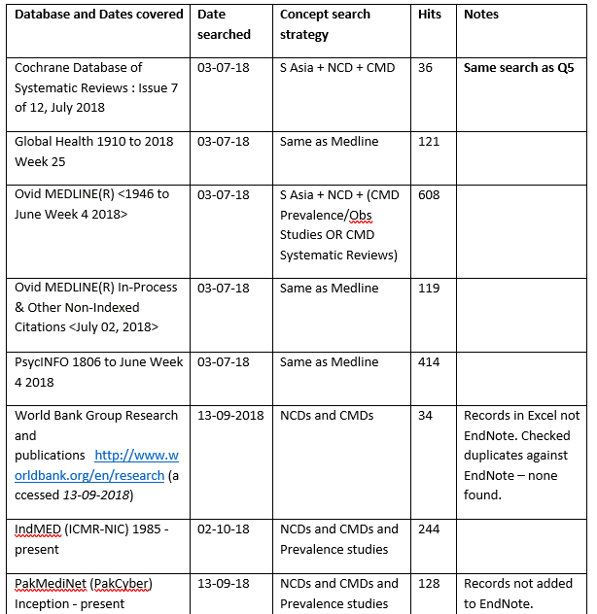
Transparent search methods Saving searches
Keep a table listing details of EVERY search you do
Save every search strategy IMMEDIATELY
Report your database name, host and coverage dates CLEARLY
Notes:
Transparent search methods – Saving searches
Search methods should be fully reported in the systematic review so readers can see where the evidence has come from, and assess how comprehensive the evidence base is.
Need to have all that detail to go into the review. Easier to collect and save search methods used when you do them, - before you forget
Keep a table of every search you do, database or website with details you need – coverage dates, date searched, numbers found, downloaded etc.
Save all search strategies into a word similar file immediately, as soon as you run them.
2 reasons for doing this.
1. You have them to hand when you are writing the search methods in the final report at the end of the review
2. As a back up for if and when something goes wrong. Saved search histories within database accounts can be lost or accidentally deleted. Also, some sources don’t have options for you to save your search history. Much easier to re-input a search if you have quick access to it in a word document.
Reporting full database names fully and consistently is challenging so we have a wiki page of them

Slide 5
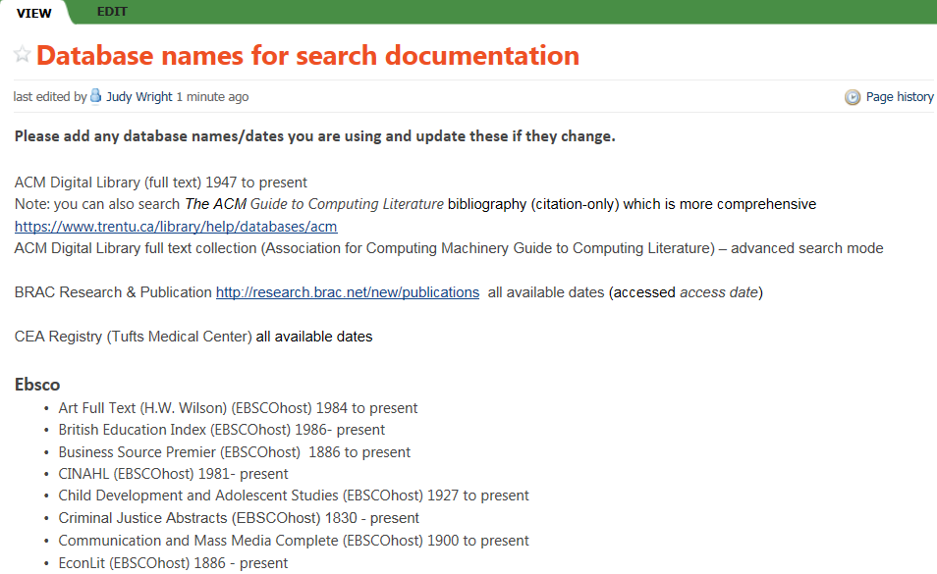
Notes:
Wiki page – Database names for search documentation
This is our wiki page listing the full names of all the databases and key web pages we search.
It’s really useful because it’s hard to remember the start dates for all the databases, and the correct format for referencing a database or source in full
It saves so much time (and is less annoying) using this page because we don’t have to keep checking every database or search file to get the correct dates. We just copy and paste database names from this wiki page and add the end date to give accurate coverage date information.
The wiki is not very attractive, we try to keep it clear and simple and spend more time on updating it and getting practical information on it than making it beautiful.

Slide 6
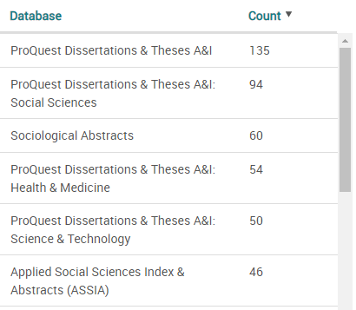
Use several databases / sources to limit bias
If the list of academic databases and grey literature is long, prioritise them.
Use published guidance for sources for your topic
Remember good sources from your previous reviews
Do a test search in a group of databases. Which ones look to have the most relevant studies?
E.g. (“green care” or “care farm*”) in Title field of ProQuest databases.
Compare numbers found in ASSIA, Sociological Abstracts, ProQuest Dissertations and Theses
Notes:
Use several databases / sources to limit bias
For systematic reviews we search several and sometime many databases, websites and other source to attempt to reduce bias, make our searches as comprehensive as possible for quantitative reviews, and for qualitative reviews we may be trying to find the most representative set of evidence
With suggestions from your review team you can quickly get a long list of sources to search and may need to make a decision on which are feasible in the time you’ve got. Agree a priority list.
Look at published research to guide which sources may be good for your topic
Use your own previous experience to guide you
IF you have access to several databases available in the same package you can do a targeted search in several databases as once, and then look to see which of the databases has the most relevant records.
For example here, if I haven’t capacity to search both ASSIA and Sociological Abstracts I could run a title-only targeted search and discover that Sociological Abstract seems to have more studies relevant to my review topic.

Slide 7
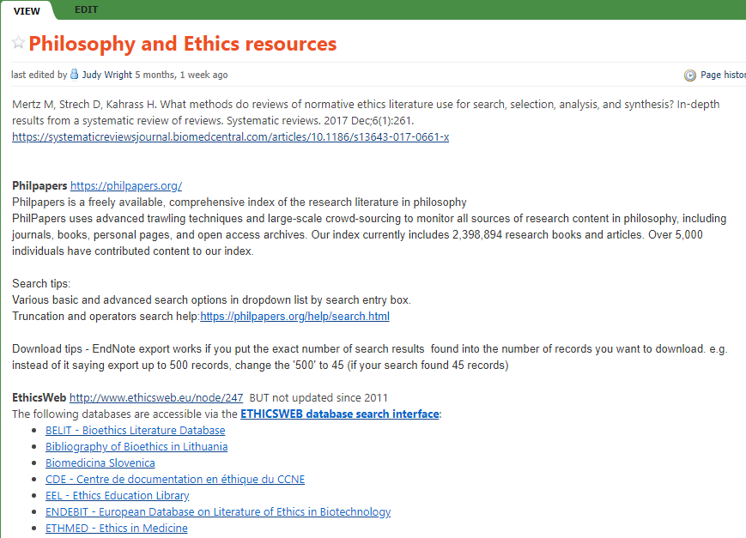
Notes:
Wiki page – Philosophy and Ethics
This wiki page is an example of where we are trying to remember good sources and search methods for a rarely searched topic – Ethics.
I collaborate on Ethics systematic reviews every 5 years or so and it’s always a learning curve to find the best sources and methods. I’ve recorded the guidance paper and good sources of literature here for future use.
Also note I’ve added some search tips and Downloading tips as the method for exporting records to EndNote was unusual and took a while to work out.

Slide 8
Manage large downloads of records
Download and save files of records from databases/sources rather than importing them directly into a reference manager
Name your saved files with the database and number of records found e.g. AKI Medline 935.ris – so you remember which database it is and how many records should be imported
Explore and learn your reference management software – push it to its limits
Notes:
Manage large downloads of records
We often find 100’s, 1000’s or even 10,000s references to studies to managing them effectively is critical
It can be time consuming to gather this information together when writing the search methods on a SR but it doesn’t need to be.
Rather than directly exporting your search results into a reference management package I’d recommend the 2 step approach where you save a file of references (often a RIS format or .txt file). And then the second step is to import that.
2 reasons for this
if something goes wrong and you need to recreate your EndNote library (at any time during the review), then you have the files ready to import. Don’t need t re-run any searches.
You can download a copy of the search strategy along with your records for some Database hosts (e.g. Ovid), so you’ve captured the search strategy easily
Name the files you save with the database you searches and the number of records you are expecting to import. That way you know how to import your file into a reference manager and you can tell if something has gone wrong and you have the wrong number of imported records. E.G. seeds of doubt.
Reference management software is so powerful and can be used to reduce some very boring jobs of removing duplicates, improving the quality of references, linking to full text pdfs, editing lots of records in a batch. Worth investing time

Slide 9
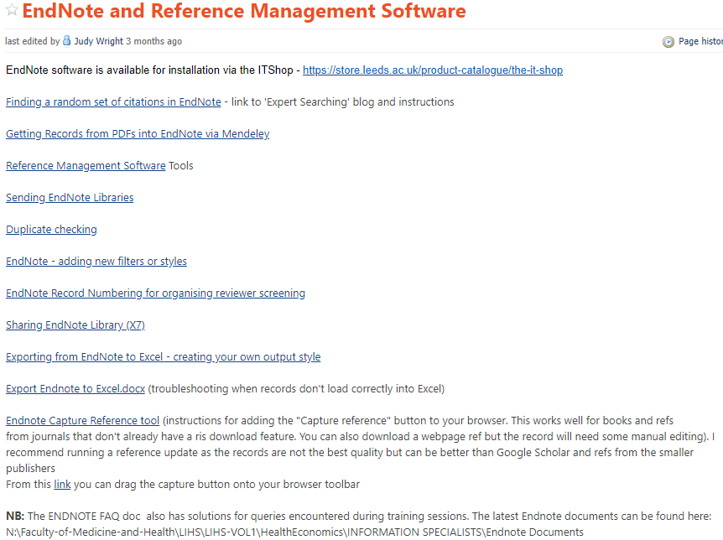
Notes:
Wiki Page – Endnote and Reference Management Software
We’ve come across lots of problems during research work and teaching, and try to collect our learning from this.
Key links are on our Wiki which are general EndNote tips but also some specific guidance for if you are at the University of Leeds.

Slide 10
Tip of the iceberg
Professional knowledge
of search methods
Institutional knowledge
for delivering search service
Frequently used
e.g. Truncation symbols
Age search filters
Frequently used
e.g. Sharing files
In-house templates
Rarely used
e.g. Subject specific sources
Exporting records from rarely used sources
Rarely used
e.g. Home access to Uni software
Process for ordering inter-library loans
Notes:
Tip of the Iceberg
I’ve shown 3 pages and explained a few tips but it is the tip of the iceberg of knowledge that all of us are accumulating over years of systematic review work. We learn something new with every review.
It’s been interesting to reflect on our Wiki and see we have two types of knowledge in there – professional ‘search methods’, and more local ‘institutional’.
Within these there are frequently used nuggets of knowledge that are hard to remember e.g. what all the different wildcard or truncation symbols are for different databases.
There are more rarely used pieces of knowledge such as Home access to EndNote which we’d advise colleagues and students on every few months.
Can you see this huge knowledge we’re all managing one way or another?

Slide 11
Knowledge is gained from?
Reading
Search methods studies, publications
Guidance e.g. Cochrane Handbook
Web-based guides
Training courses
Sharing and reflecting on practices with colleagues
In the office
Mailing lists, twitter, LIS-Medical, ExpertSearcher…
Solving a problem yourself (learn by mistakes)
Notes:
Knowledge is gained from?
We acquire knowledge in different ways. This is personal to me – think I’ve gained my knowledge from reading published research and guidance, going on training courses and sharing ideas and practices with colleagues whether that’s in the office, on twitter or by the brilliant mailing lists such as expertsearcher, LIS-MEDICAL.
Also we work things out ourselves and this knowledge may remain in our heads, not shared.

Slide 12
Where to access and how to manage Systematic Review search knowledge?
Before we had a wiki I saved instructions and practical tips in various documents. Some were in shared folders, some in my personal computer folders. I had lots of sticky notes and bits of paper on the wall I could pass to colleagues. Tips were buried in emails and big lists of web bookmarks. Some was just in my head and I hadn’t realised I hadn’t shared it.
I still try to access knowledge from lots of sources, but we as a team have streamlined where we save incoming guidance and tips to an EndNote library of papers, Netvibes page, Shared folder (small amount) and our Wiki.
Notes:
Where to access and how to manage Wiki
Before we had a wiki I saved instructions and practical tips in various documents. Some were in shared folders, some in my personal computer folders. I had lots of sticky notes and bits of paper on the wall I could pass to colleagues. Tips were buried in emails and big lists of web bookmarks. Some was just in my head and I hadn’t realised I hadn’t shared it.
I still try to access knowledge from lots of sources, but we as a team have streamlined where we save incoming guidance and tips to an EndNote library of papers, Netvibes page, Shared folder (small amount) and our Wiki.

Slide 13
AUHE Info Specialists Wiki
126 pages, 6 years old.
Practical tips for search methods for a range of review types.
Signposts to external, guides, webpages and links to ‘internal’ documents and instructions.
Thanks to Thomas Veale for getting us started.
Thanks to Kirstine McDermid, Rocio Rodriguez-Lopez, Donna Irving, Naila Dracup, and Natalie King for contributions over the years.
Notes:
AUHE Info Specialist Wiki
Started 6 years ago and has grown to 126 pages
Focussed on simple, clear practical tips but also signposting to other detailed material
Thanks to Thomas Veale it was his idea. Also thanks to information specialists who have contributed.

Slide 14
A “work in progress” wiki - Demo
Notes:
Go to Demo of PB Wiki

Slide 15
Reflections on team use - but everyone is a bit different!
Used a few times a day to at least twice a week
Update content every 2 weeks to every 2 months
Navigate via search tool bar
Useful for double-checking e.g. wildcard symbols
Useful when learning a new method e.g. Rayyan
Heavily used:
Database full names, Truncation and wildcard symbols, Animal and Age-group searches
Notes:
Reflections on team use
In preparation for this talk I’ve been discussing with our team how we use the Wiki – some variation

Slide 16
Positive feedback
Easier than having instructions saved in Word documents.
User friendly and intuitive.
Quick practical tips – don’t need to read a whole article to establish …“what you need to do right now”.
Great for reminders of tasks (paperwork) you do often but not enough to be embedded in the memory.
Saved me a lot of time checking things.
V easy to add content to existing pages.
Good for everyday work.
Search facility works really well.
I love it.
Notes:
Positive feedback
Everyone likes it’s ease of use, and particularly easy to add content.
They find it time-saving
They like that information is distilled into a short tips and instructions, so there is not much reading to do

Slide 17
Not so good
Visually not that attractive.
Emails all users every time a page is edited.
Creating and linking a new page is less intuitive.
Some content is old and outdated.
Fiddley to change page titles and keep links between pages.
Some content difficult to find if you don’t search with the right words.
Notes:
Not so good
A few aspects are not so good but we have no serous issues with it.
Its not a very attractive interface
Every time a page is edited an email is sent all the wiki participants. On the one hand this is useful to be notified of some new information being added, but on the other if its just a typo being corrected then getting emails about that is annoying.
We are very aware that some content is now quite old and outdated. You can see when a page was last edited and staff try to update or at least indicate if the content is out of date.
When you are creating pages you have to think carefully about the page title as this is what is used for hyperlinking between pages. If you change the page title at a later date the hyperlinks to and from that page will not work, unless you go back and update all the hyperlink
Finally, occasionally its difficult to find content you know is in the wiki because you are not searching the right words.

Slide 18
My PBworks https://my.pbworks.com/
Features
Free version or subscription
Private or public content
Automated notifications
Editing – no coding required
Accessible to people inside or outside of your organisation
Recommend you do not add confidential / personal data
Free account includes:
Up to 15 internal users
Up to 5 external users
Up to 5 wikis
50 MB of storage
Free email customer support
Notes:
MyPB Wiki
This is a quick look at the features of free Pbworks. You simply sign up with an email

Slide 19
Getting your team engaged
Plan structure and content of wiki together.
Provide editing training and support.
Stress the importance of getting the tips into the wiki, not making it look perfect or be ‘complete’.
Encourage or task everyone to add specific content.
Move your time-saving tips out of buried folders and post-its and onto the wiki.
When discussing problems, send links to the relevant wiki page.
Get new staff involved – it’s a useful training resource.
Notes:
Getting your team engaged
Our wiki work’s best when everyone’s involved, adding their expertise, gradually refining and updating the guidance.
We’re trying to avoid staff spending time doing a boring repetitive task when someone has already discovered a work-around.
Work together on it and give plenty of support as it can be daunting using completely new software.
Encourage staff to just add brief note and links, and not worry if it doesn’t look perfect or isn’t a complete guide.
Use it as a training resource and send links to relevant material on the wiki whenever possible

Slide 20
Wider sharing
Limited sharing possible with free PB Wiki.
Problem of irrelevant internal guides.
‘Work in progress’ feel encourages the team to quickly add information.
BUT the structure and some content could be shared.
Great publicly available websites with some practical systematic review search tips.
Notes:
Wider Sharing
We’ve talked in our team about sharing the wiki more widely but there are several problems with this. One is that we’d need to pay or use a different platform. Also, it contains material that is very specific to staff working at the University of Leeds. Finally, one of the strengths is that being for ‘internal use’ in our small team we don’t feel the need to make it perfect and complete. We do put some guidance on our website but this it time consuming to brand it, research it thoroughly and double check it is fit for public use. This would post a major barrier to our staff just quickly adding useful tips as they come across them in emails and daily working.
However, there is useful content in here and we felt the idea of an internal wiki and the structure of our wiki could be useful to share.
There are some brilliant web page written by information specialists with some practical tips already out there and perhaps we should try to add to those?

Slide 21
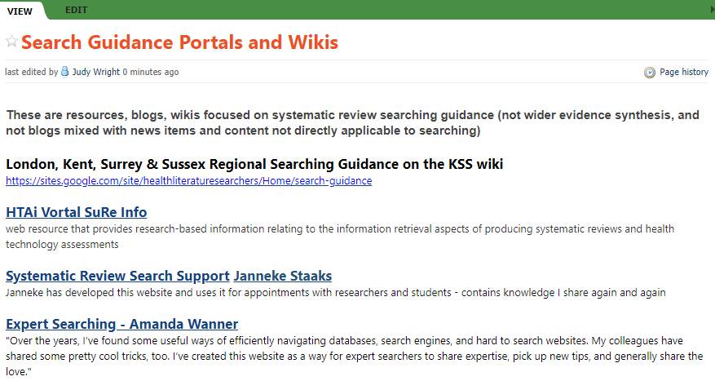
Notes:
Wiki Page – Search Guidance
Here is our wiki page listing some of those. There are more but these are a few key ones we’d use to start with.

Slide 22
Final thoughts…
Keeping up to date and remembering search methods for all the databases, software and review types is difficult.
Knowledge fades but can spring back with a prompt.
Central resource helps you remember and whole team share their collective expertise.
Share how you can remove some boring or repetitive tasks.
Notes:
Final thoughts
I was asked to draw on my experiences of systematic review searching over the last 17 years and talk about barriers and challenges I’ve encountered and overcome.
Systematic review methods, searching, software, the volume of literature and the range of subjects covered by reviews has changed so much and continues to change at pace that keeping up with good practice is a challenge.
We learn something new with every review and sadly our knowledge fades but having a central resource such as a wiki helps keep hold of that knowledge generation and allows it to be shared.
Thank you for taking the time to listen. I’m happy to take some questions if there are any,

Slide 23
Q & A
1. From Sarah Bruch : Is this Wiki available to us? o From Shirley Yearwood-Jackman : Is this wiki closed or open to practitioners o
- From PF Anderson : Closed. http://auheinfospec.pbworks.com/ o
From Judy Wright: It is not openly available, up to 15 users can be invited to the freely available PB Works wiki. •
2. From Annemarie Frank : Are you referring to Endnote Web or EndNote desktop? o
From Judy: EndNote Desktop • From Deirdre Andre : How do you keep the wiki pages up to date? o From Judy: mostly on an ad hoc basis though we have a priority list of pages we plan to update and populate more fully on our ‘to do’ list. We update pages or add new pages: ▪ when we learn something new e.g. when searching a database new to us ▪ when a colleague shares a useful tip on a mailing list / twitter ▪ when we undertake a training course and have key tips to share ▪ new staff develop pages as part of their training
3. From Kath Wright : don't all the wiki entries need to be dated?? items from a few years ago may no longer work??
From Cathryn Peppard : I believe, from my personal use of PB wiki, it dates edits so you could check that way?
From Judy – Each page displays when it was last updated and by whom. There is also a ‘page history’ button on each page that expands to show dates of all previous edits. You need to manually enter a summary of the changes you make to the page if you want to record this

Slide 24
Q & A
4. From Rebecca Evans : General question - the most common question I get asked by students is "how many results should I have?" I don't think there is an exact answer, but I think my answer is always not reassuring! Any advice for a more helpful answer?
From Andrew : The published average is 2 to 3 relevant results per 100 records. So if they are getting less they should improve specificity and getting more should look at sensitivity
From Andrew : Sampson M, Tetzlaff J, Urquhart C. Precision of healthcare systematic review searches in a cross‐sectional sample. Research synthesis methods. 2011;2(2):119-25. https://onlinelibrary.wiley.com/doi/abs/10.1002/jrsm.42
From Judy: No there isn’t an exact answer but it’s helpful for students to understand review search results are often in their 1000’s – this can come as a shock to some. The review question dictates the size of the search results, so tightly bound questions will find fewer results. Some topic areas have large search results e.g. Diagnostic Accuracy and Public Health reviews. If the question comes from a student learning the theory of systematic reviewing then the best answer is to do a scoping search, check specificity (as per Andrew’s answer) and be aware search results can vary widely. For students working on their own time-limited Master’s ‘systematic review’ project a screening workload of 500-1500 abstracts seems feasible in the time they have, so ensure they have time to practice other parts of the review methods. However, I would still underline that broad question produces many more results so if there isn’t capacity for this, the question needs to change.

Slide 25
Q & A
From Bayram Sari : 1. Could discovery services be sufficient for undergraduate or masters students, if it is covering a wide enough range of databases? @ LSBU we had discussions around what to recommend to undergraduate and masters students for SR: Discovery services (EDS in our case) vs native databases. o
From Judy – I’ve not read literature on this (someone may have done a study on this) to check how well Discovery services work for reviews. For me, the issues are 1) we need to undertake and document reproducible and transparent searches and 2) be able to download a defined set of records with abstracts. It sounds cumbersome to list all sources in Discovery service, but as different institutions sign up to different packages I think you would need to transparent about this. Do your Discovery search results give you same access to abstracts as native databases for the screening stage? If your discovery search produced a large number of records would you screen all of them or the first 1000? If screening a subset you would need to be clear (As for google searching) how the results were sorted and where your cut-off point was
From Linda Liu : Does somebody have overall editorial responsibility to make checks and deduplicate the information on there? o
- From Judy. Not formally. Everyone is encouraged to check content they see of there and either edit or notify the team if they notice something incorrect or duplicated. It’s a small team (3) so we manage it between us. I’m more likely to spot duplicate information and do more top level editing as I’ve been using it the longest and most familiar with it’s content.

Slide 26
Q & A
From Medical Library : How long did it take to create the content for this Wiki (I assume new pages get added when new tools/techniques arise, but I mean how long did it take to create the content which existed when it was ‘launched’)? o
- From Judy. The first version of the wiki was launched with only a couple of pages that took an hour or two – it was experimental and gradually grew. BUT, a year or so later we created a new Wiki. Version 2 was planned and constructed in similar way to a website. We decided the structure, key information to add first and sections we wanted to eventually populate over time. We already had quite a lot of the content either from the first version Wiki or other documents, and rough structure from our Version 1. I’d guess it took about 1 day in total (with meetings) to plan and create the structure and main sections of the wiki. Then it took a few days for 1 person to add the key content we had and put the links in so we could launch it. We created the 2nd (current) version over 2-4 weeks when we had new staff working in the team. It would take longer if you have contents stored in may different places that needs gathering before you start.

Slide 27
Comments from attendees
From Selina Lock : I always recommend making regular back-ups of EndNote desktop libraries using the compressed library option. •
From LinaGulhane : sometimes you have more than one database file, maybe you can name them for e.g. AKI Medline 935, AKI Medline2 999 •
From Regina Küfner Lein : I like your tips of saving the ris-files. Two days ago I did a search and today the researchers wanted me to make an EndNote library. If I had saved the ris-file ….. •
From jpe : recommend adding the date run to the saved file. •
From Valeria Scotti : Also with data...in case you have to reapet the resarch after one month to see if new article are published •
From Karine Barker : so impressive to have spent additional time to organise all these tools and tips •
From Deirdre Andre : It would be great to have a more generalised wiki that all information specialists doing systematic review searching could contribute to. •
From Jane Falconer : JISC EndNote licence has changed and is now free to download to licenced institutions - talk to who buys the licence if you're unsure abt situation in your institution •
From Isla (co-chair) : comment for Judy - this is such a great developmental tool for new staff, or those new to SRs. •
Links to blogs mentioned in Judy’s presentation: o Amanda Wanner https://expertsearching.wordpress.com/author/voltarad/ o Janneke Staaks https://osf.io/49t8x/ o •
From Coral Pepper : Thank you Judy - so useful and definitely something we could do with in our team! Great practical tips. •
From Katie Barnard : Really useful - really need to create something like this with my colleagues. Thank you! •
From Lynsey Sampson : Wikis sound the way forward! Great knowledge base! Thanks Judy! •
From 44780 : Great tip and useful for learning and training, thank you Judy

