Slide 1
Academic Unit of Health Economics
Leeds Institute of Health Sciences
Developing Target Product Profiles for medical tests: a methodology review
Paola Cocco, Anam Ayaz-Shah, Michael Messenger, Robert West, Bethany Shinkins
umpc@leeds.ac.uk
@paola__cocco

Slide 2
Background: Target Product Profiles
Many innovative diagnostic tests fail to be introduced into the market and adopted into clinical practice
TPPs embody the concept of ‘beginning with a goal in mind’
Notes:
Many innovative diagnostic tests fail to be introduced into the market and adopted into clinical practice. Possible reasons for this include:
New diagnostic tests are mainly driven by laboratory discoveries rather than innovation based on current unmet clinical needs. Therefore many of the newly developed tests are unlikely to be ‘fit for purpose’.
The evidence requirements for new tests are extensive, requiring significant investment and can be time consuming to produce. A previous review found that this process took 9 years on average for new point of care tests. Diagnostic technologies are developing at a rapid rate. By the time a new test has been fully evaluated, the technology may be obsolete.
There are often many contextual and infrastructure factors associated with the implementation of a new test which must be well understood prior to development to ensure they don’t become barriers to adoption.
Target Product Profiles, known as TPPs, offer a possible solution to these issues.
They summarize the necessary characteristics, performance specifications a test should have to address an unmet clinical need. They are strategic documents, targeted at test developers, outlining technical solutions to current clinical problems. They are also ‘living’ documents which are updated as new evidence becomes available.
TPPs could also be used by commissioners as a guide as to whether a new test or competing tests meet the standards required to provide a solution to a clinical problem
TPPs also factor in contextual and infrastructure requirements, flagging up in advance any potential barriers to implementation in real world clinical practice

Slide 3
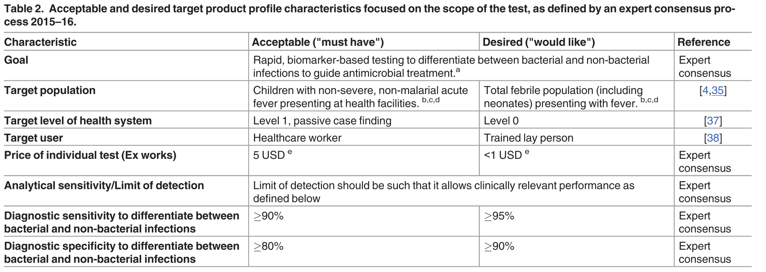
Dittrich S, et al. Target Product Profile for a diagnostic assay to differentiate between bacterial and non-bacterial infections to guide antimicrobials use in resource-limited settings: An expert consensus.
Notes:
This slide gives you an example of a published TPP summarising some of the requirements a new test should possess. As you can see, the specifications are labelled either acceptable i.e. characteristics that are required, or ‘desirable’ – characteristics that would be nice to have.
Example of target user

Slide 4
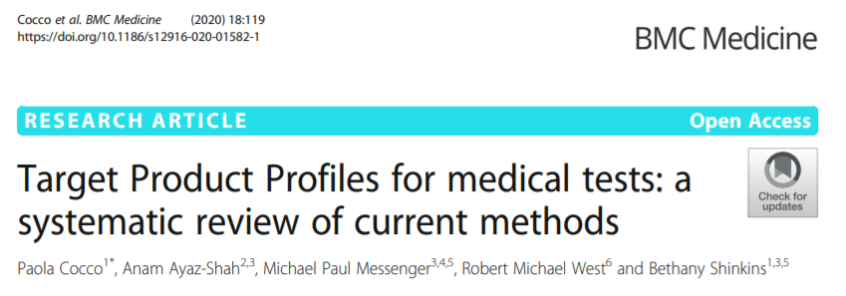
Methodology systematic review of TPPs
Which test characteristics are included in TPPs?
How are test characteristic requirements derived and agreed upon?
Which stakeholder groups are involved?
Notes:
There is no formal guidance or best practice methodology for developing a TPP for medical tests. We then conducted a systematic review to better understand the methods that are currently used to develop TPPs for a medical test.
Specifically, we were interested in which test characteristics usually feature in a TPP, how the test characteristic requirements are derived and agreed upon, and the stakeholder groups involved in the TPP development process.
Now I will present the methods and main findings of the systematic literature review of TPPs. This is freely available in BMC Medicine.

Slide 5
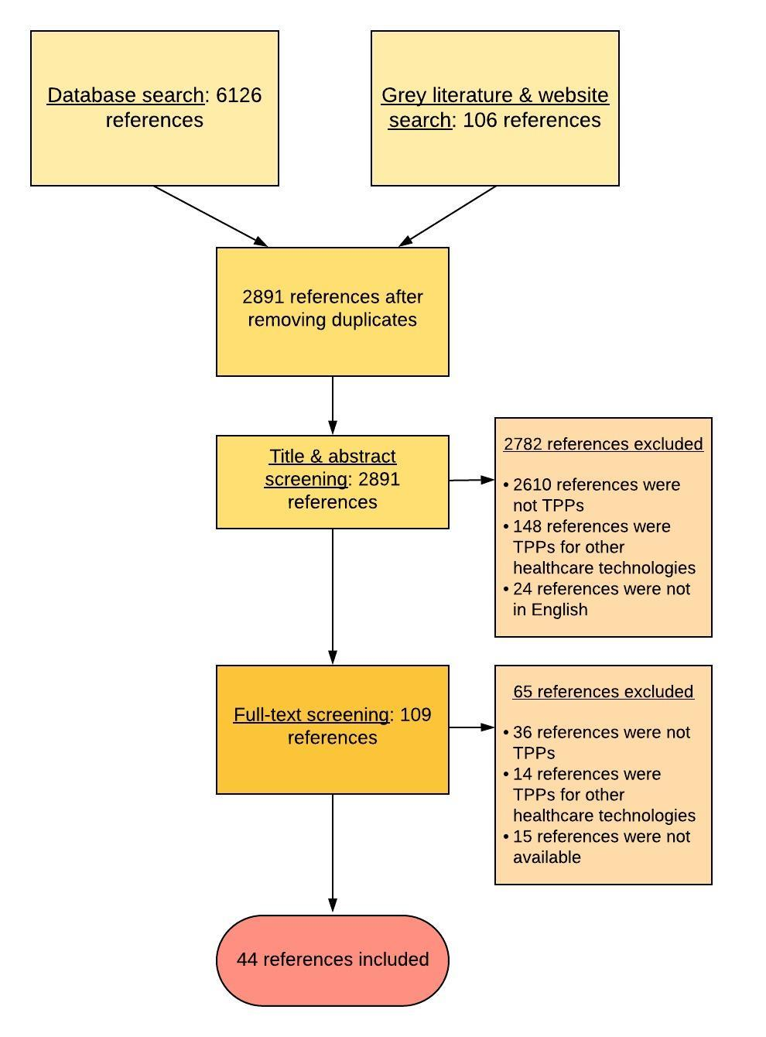
Notes:
We conducted a systematic search of literature databases and websites
TPPs written in English for any medical test were included
Reference sifting and data extraction was conducted independently by two reviewers.
We conducted a transparency assessment of each TPP: we were interested to see how transparent TPPs were in reporting their methods, the evidence used to inform recommendations, and the stakeholders involved

Slide 6
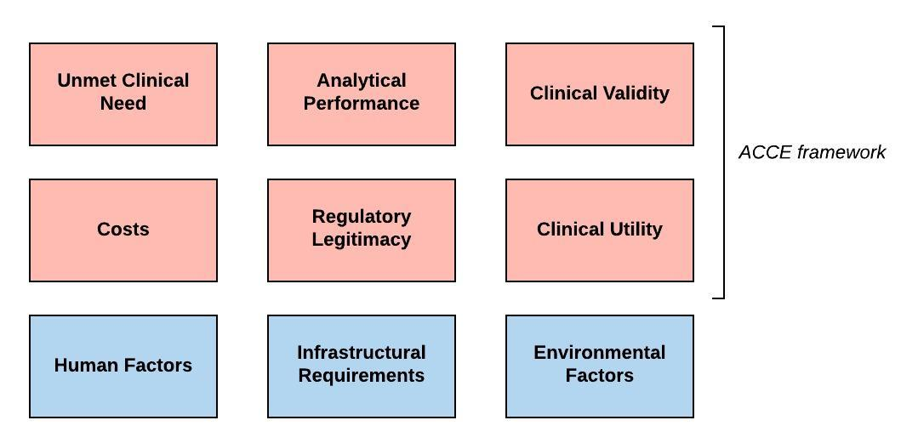
Common themes for test characteristics
Burke W, Zimmern R. Moving beyond ACCE: An expanded framework for genetic test evaluation
Notes:
The test characteristics included in each TPPs were categorised into commonly recognised themes as you see in the figure
Clusters highlighted in red were based on the enhanced version of the ACCE framework
Clusters highlighted in blue, namely human factors (focusing on the interaction between users and devices), environmental factors and infrastructural requirements were created for those test characteristics which did not fall into the red clusters

Slide 7
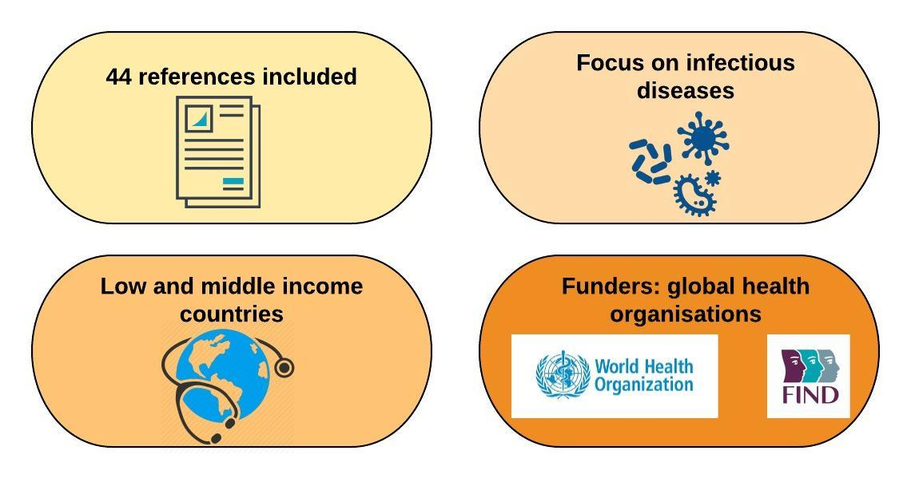
Features of included TPPs
Notes:
We included 44 references, the majority of which composed by reports, followed by journal articles
All TPPs provided guidance on medical tests aiming to detect infections
For the majority, the healthcare setting of interest was low- and middle-income countries
TPPs were generally funded by global health organisations, such as WHO, FINDDx and Bill and Melinda Gates Foundation

Slide 8
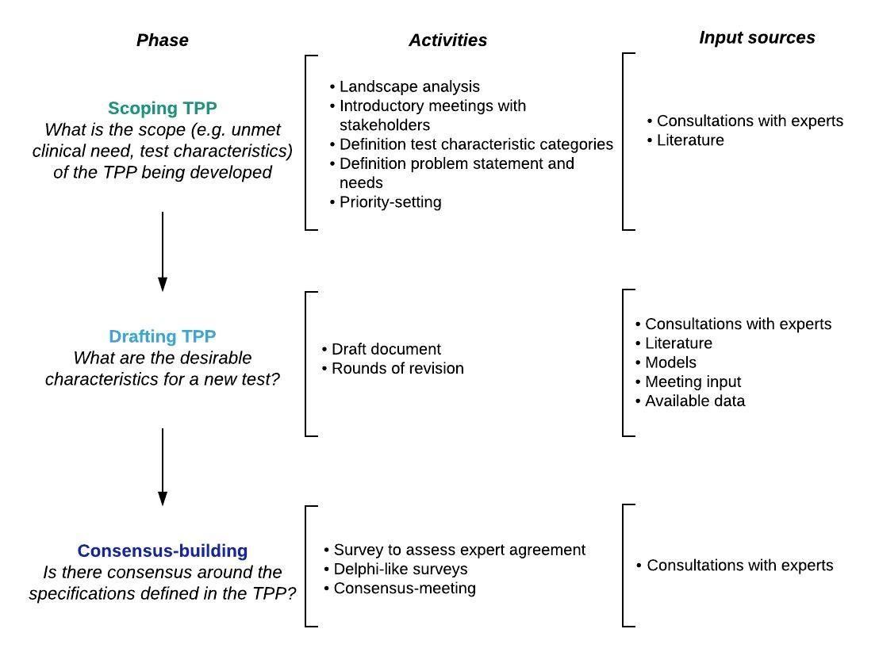
Typical TPP development process
Notes:
Across the TPPs identified, there was a common development process comprising of three decision-making phases: scoping, drafting, and consensus-building.
The aim of the scoping phase is to identify the focus of the TPP under evaluation, both in terms of unmet clinical need and which test characteristics should be included in the TPP. Half of the included TPPs underwent the scoping phase by conducting either landscape analyses, meetings with stakeholders, definition of problem statements and prioritisation exercises. This phase is usually informed by literature and consultations with experts.
The drafting phase entails developing and revising the TPP many times to refine the draft. Consultations with experts, literature, appeared to be the main input sources, followed by models and available data.
The third and final phase, consensus-building phase aims to gather stakeholder’s views and consensus on the TPP through surveys and consensus-meetings.
Across all phases of TPP development, the most frequently involved stakeholder groups were academic researchers, industry representatives, international public organizations, clinicians and members of disease-specific programs.

Slide 9
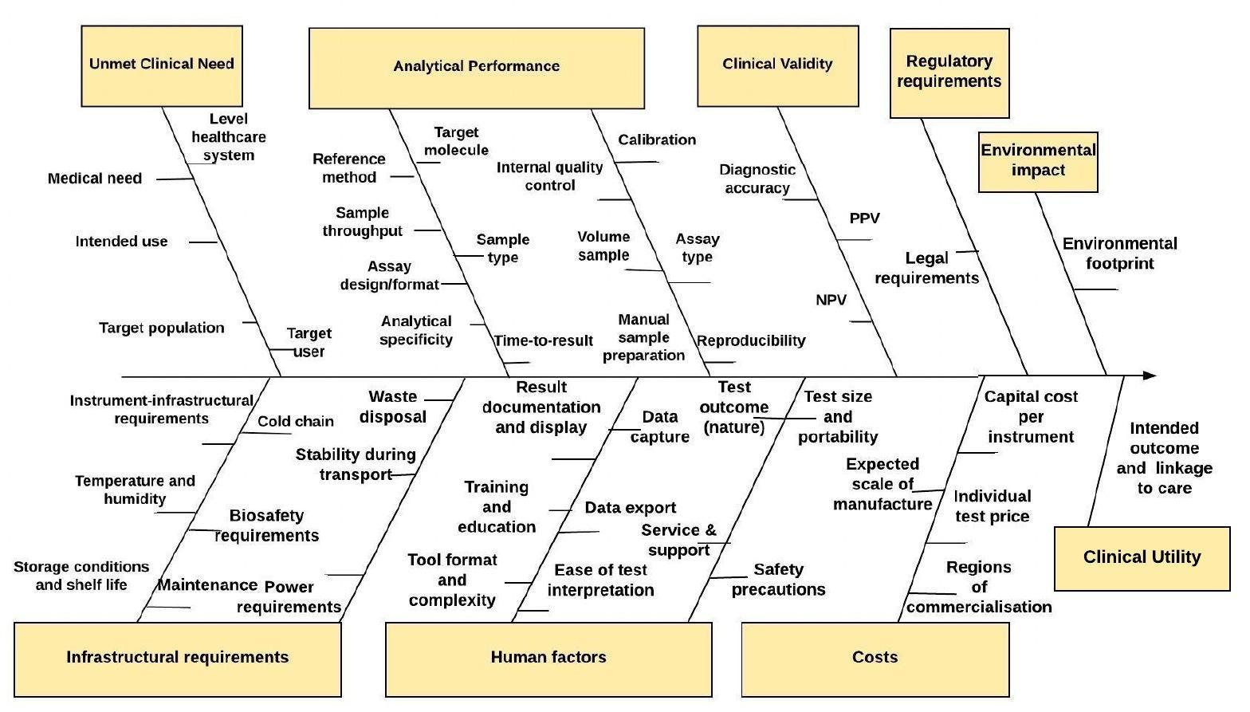
Most frequent test characteristics
Notes:
This figure shows the most frequent test characteristics among the TPPs we have screened, clustered into categories
Unmet clinical need: intended use, patient population
Analytical performance: analytical specificity, manual sample preparation, time to test result
Clinical validity: clinical sensitivity, specificity, predicative values
Infrastructural requirements: operating and storing conditions, power requirements
Human factors: test outcome nature, test size and portability, training and education
Cost: individual price cost, capital cost per instrument

Slide 10
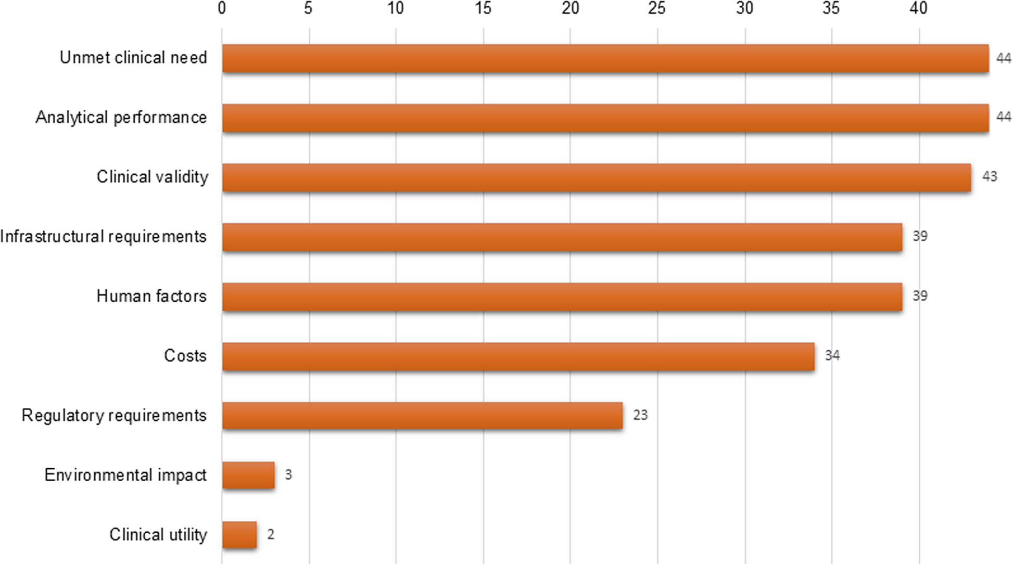
Test characteristic categories
Notes:
This figure reports the test characteristic categories in absolute number of included TPPs
All TPPs included some characteristics on unmet clinical need, analytical performance and clinical validity for the test being described
The majority of TPPs mentioned desirable characteristics about human factors, infrastructural and regulatory requirements and costs
On the contrary, only 3 TPPs provided some guidance on the test environmental footprint, whilst two TPPs featured specifications on test impact on patient health, namely test clinical utility.

Slide 11
TPPs are useful guiding documents for test manufacturers
Primary focus on infectious diseases might be driven by the remit of global organisations who fund TPPs (e.g. WHO R&D Blueprint)
TPPs could support both international and national health decision-makers in stimulating innovation of new tests driven by any clinical need
Notes:
We believe that TPPs could be extremely useful for test manufacturers as they identify upfront which test characteristics a new test should have to fulfil a pre-specified unmet clinical need.
This review shows that all TPPs provided guidance on medical tests on infectious diseases. The primary focus on infectious diseases may be explained by the remit of the global organizations who usually fund TPPs. For instance, WHO established the ‘R&D Blueprint’, which aims to promote R&D activities (tests, vaccines, medicines) during epidemics by commissioning TPPs to guide the development process.
We believe that the development of TPPs should not be limited to one specific disease area or clinical setting; the concept of ‘beginning with an end in mind’ embodied by TPPs could support both international and national health decision-makers in stimulating innovation of new tests in any disease area.

Slide 12
No focus on clinical utility and cost-effectiveness of new tests
High test accuracy ≠ improvement in patient health
Poor quality of input sources (expert judgement and literature)
Few TPPs considered modelling results and available data for validation
Poor transparency in reporting methods
Lack of generalizability and reproducibility of TPPs
Notes:
We have also identified some methodological limitations relating to current TPP development.
First, very few of the TPPs reported characteristics relating to the impact a new test should have on patient health, whilst cost-effectiveness was completely overlooked.
TPPs reported desirable costs/price of a test, but none of these requirements was based on cost-effectiveness estimates. We believe that it is important to consider the cost of a new text in the context of the benefits that the test may provide. For example, a new test may be relatively expensive but may also improve patient health to the extent that the additional is justified.
2. Second, current TPP methodology relies solely on non-systematic searches of the literature and expert opinion as main sources for desirable characteristics.
3. There was also a lack of transparency in terms of the methods used to develop the TPPs. For example, few TPPs reported how the expert selection process took place and which literature TPPs were based on.

Slide 13
Future research
Systematically identify unmet clinical needs for new tests
Incorporate the assessment of desirable clinical utility and cost-effectiveness of new tests
Care pathway analysis & early economic modelling
Understand the value of TPPs for test manufacturers
Integrate TPPs into regulatory paths for innovation
Guidance on best practice methods for developing TPPs for medical tests is needed
Notes:
Finally, we have identified some areas for future research in relation to the current TPP methodology.
Future research should focus on developing methods to systematically identify unmet clinical needs for new tests.
It is also important to understand how to better incorporate the assessment of desirable clinical utility and cost-effectiveness of innovative tests into TPPs. One possible way forward could be exploring how and if care pathway analysis and early economic modelling could be integrated into the development of TPPs. Care pathway analysis would provide clarity on the mechanisms by which a test could impact on downstream patient outcomes, whereas early economic modelling could be used to define desirable values for certain test characteristics (e.g. test price, diagnostic accuracy) based on cost-effectiveness.
It might also be informative to understand if test developers see any value in TPPs, if there are any obstacles to fulfilling the requirements featured in TPPs while developing new tests.
Most importantly, future research should focus explore how TPPs could be integrated into existing regulatory paths for innovation (e.g. EU Regulation for In Vitro Diagnostics) to ensure that TPP characteristics align with evidence requirements which are relevant for market approval of new medical tests.
We believe that pursuing research in all these areas will ultimately inform guidance on best practice methods for developing TPPs for medical tests.

Slide 14
Thanks for your attention!
Any questions?
umpc@leeds.ac.uk
@paola__cocco

Slide 15
Click here link to watch the pre-recorded presentation

