Slide 1


Academic Unit of Health Economics
Leeds Institute of Health Sciences
Developing a framework based on early economic evaluation to inform Target Product Profiles for new diagnostic tests
Paola Cocco
Some of the work presented related to unpublished work – please do not disseminate without the author’s permission
Notes:
During this presentation, I will discuss the key findings and methods from my PhD which focuses on integrating early economic evaluation into the development of Target Product Profiles for new diagnostic tests.

Slide 2
Presentation outline
Background on Target Product Profiles (TPPs)
Systematic review on TPP methodology – key findings
Integrating early economic evaluation into TPP development
Project aim & objectives
Case study – Clostridium difficile infection (CDI)
Discrete event simulation model for rapid CDI diagnostics
Notes:
I will start by giving some background information on Target Product Profiles (TPPs) for medical tests, followed by some key findings from a systematic review I have conducted to explore the current TPP methodology. I will then discuss how and to which extent it is possible to integrate early economic evaluation into TPP development for medical tests. During my PhD, I have then applied the EEE methodology to a case study example – a new point of care test for Clostridium difficile infection –to define desirable performance specifications for new tests. I will then present the structure, analysis and key findings of a discrete event simulation model for rapid CDI diagnostics I have built.

Slide 3
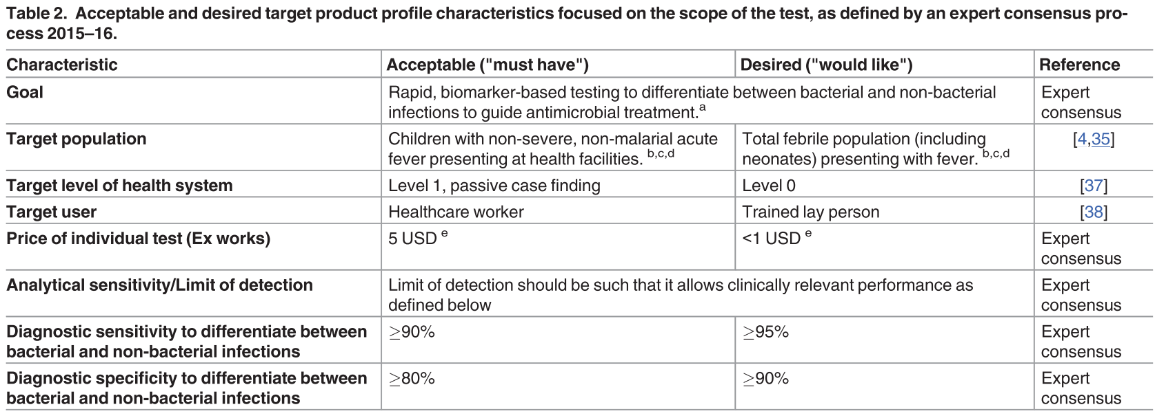
Target Product Profiles
TPPs define minimal acceptable and desirable characteristics of a test to meet an unmet clinical need
Dittrich S, et al. Target Product Profile for a diagnostic assay to differentiate between bacterial and non-bacterial infections to guide antimicrobials use in resource-limited settings: An expert consensus.
Notes:
My PhD project focuses on Target Product Profiles (TPPs) which are strategic documents, targeted at test developers, summarising at early development stages the key properties a new (or existing) test should possess in order to fulfil an unmet clinical need.
Within TPPs, the specifications are typically labelled either acceptable – characteristics that are required – or desirable – namely characteristics that would be nice to have. TPPs should be seen as ‘living’ documents which are updated once new evidence becomes available.
This slide gives you an example of a published TPP for tests to differentiate between bacterial and non-bacterial infections. Ideally a trained lay person should run this new test, otherwise it might be acceptable for a healthcare worker to run the test.

Slide 4
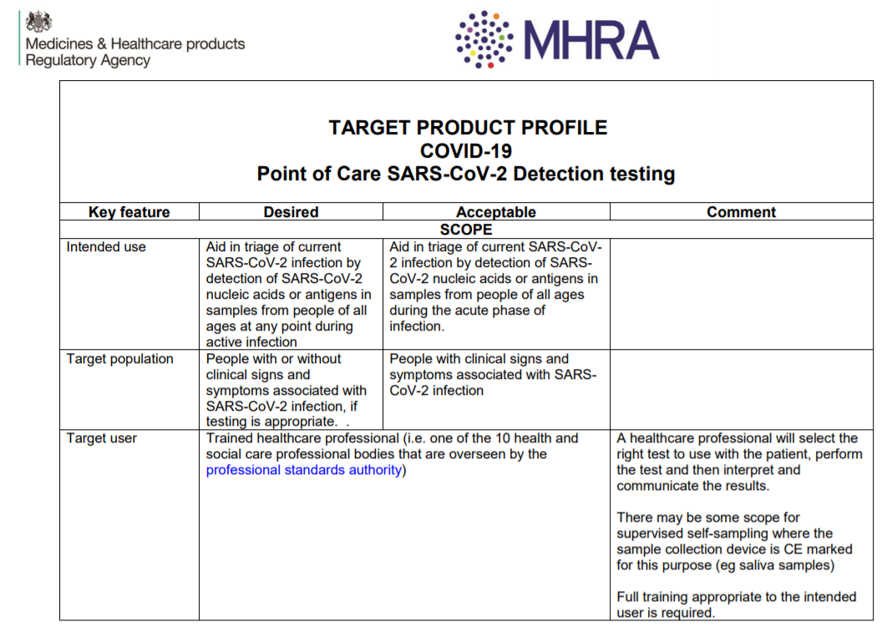

Target Product Profile – COVID-19 diagnostics
Notes:
In response to the COVID-19 pandemic, international and national organisations have published TPPs as a means to steer technology research and development for new diagnostics. For example the WHO has issued several TPPs for healthcare interventions to tackle the COVID-19 pandemic, including vaccines and diagnostics . In the UK, the Medicines & Healthcare products Regulatory Agency (MHRA) developed a series of TPPs for COVID-19 tests aimed at assisting manufacturers to design and deliver tests to support the UK’s testing strategy and inform the validation, procurement and regulatory decision-making.

Slide 5
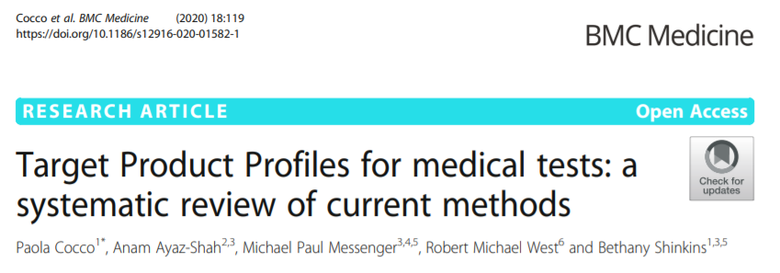
Methodology systematic review of TPPs
  Which test characteristics are included in TPPs?
  How are test characteristic requirements derived and agreed upon?
  Which stakeholder groups are involved?
Notes:
There is no formal guidance or best practice methodology for developing a TPP for medical tests. I have then conducted a systematic review to better understand the methods that are currently used to develop TPPs for a medical test.
Specifically, I was interested in which test characteristics usually feature in a TPP, how the test characteristic requirements are derived and agreed upon, and the stakeholder groups involved in the TPP development process.
Now I will present the main findings of the systematic literature review of TPPs. This is freely available on BMC Medicine.

Slide 6




Features of the included TPPs
Notes:
44 references were included, the majority of which composed by reports followed by journal articles
All TPPs provided guidance on medical tests aiming to detect infections, in the context of low and middle income countries.
TPPs were generally funded by global health organisations, such as WHO, FINDDx and Bill and Melinda Gates Foundation

Slide 7
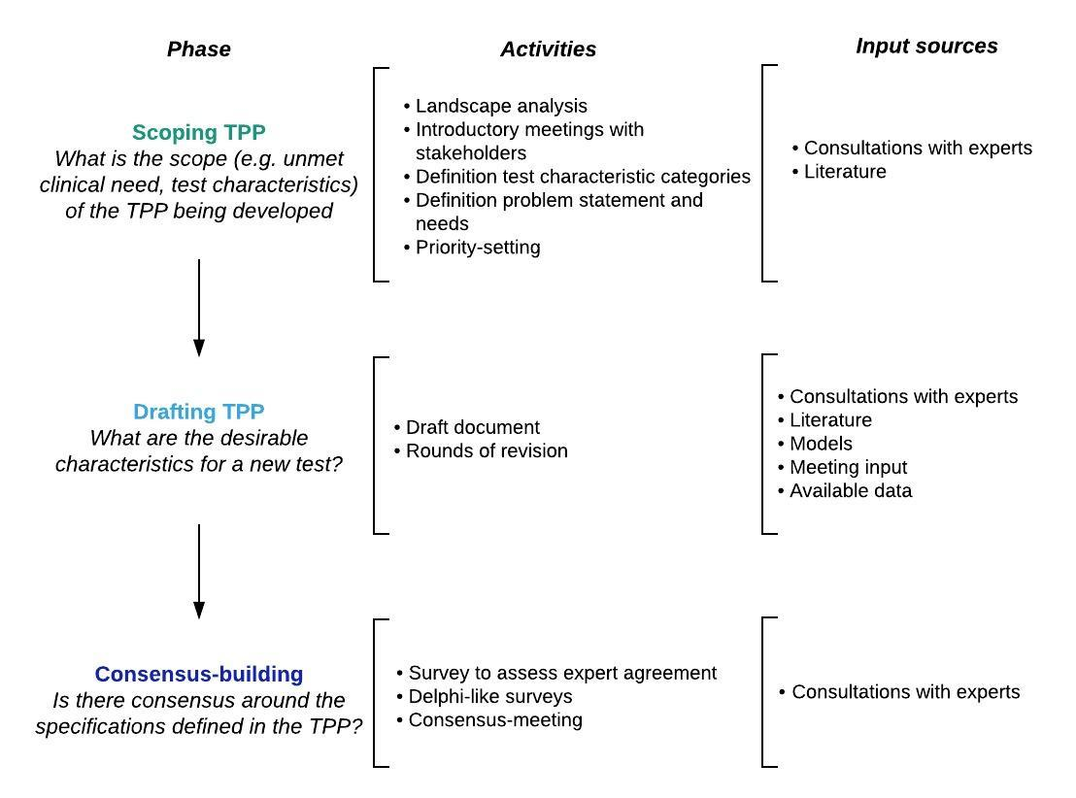
Typical TPP development process
Notes:
Across the TPPs identified, there was a common development process comprising of three decision-making phases: scoping, drafting, and consensus-building.
The aim of the scoping phase is to identify the focus of the TPP under evaluation, both in terms of unmet clinical need and which test characteristics should be included in the TPP. This phase usually includes a landscape analyses, meetings with stakeholders, definition of problem statements and prioritisation exercises. This phase is mostly informed by literature and consultations with experts.
The drafting phase entails developing and revising the TPP many times to refine the draft. Consultations with experts, literature, appeared to be the main input sources, followed by models and available data.
The third and final phase, consensus-building phase aims to gather stakeholder’s views and consensus on the TPP through surveys and consensus-meetings.
Across all phases of TPP development, the most frequently involved stakeholder groups were academic researchers, industry representatives, international public organizations, clinicians and members of disease-specific programs.

Slide 8
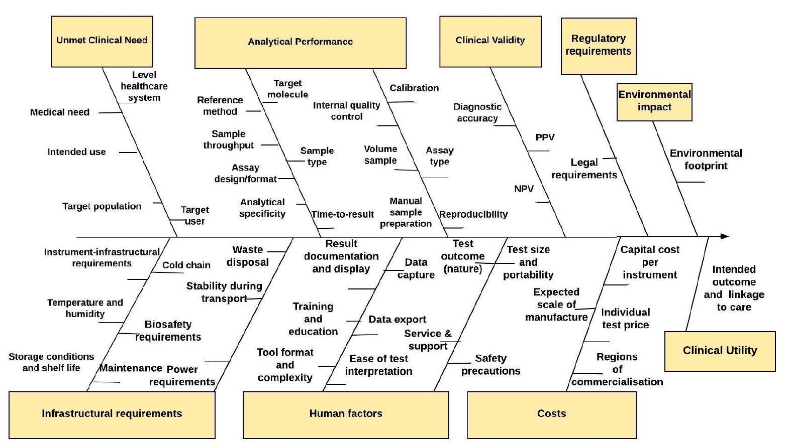
Most frequent test specifications
Notes:
This figure shows the most frequent test characteristics among the TPPs we have screened, clustered into categories
Unmet clinical need: intended use, patient population
Analytical performance (the ability of a test to detect and measure a certain analyte): analytical specificity, manual sample preparation, time to test result
Clinical validity (the ability of a test to yield results that are correlated with a particular clinical condition): clinical sensitivity, specificity, predicative values
Infrastructural requirements: operating and storing conditions
Human factors: test size and portability, training and education
Cost

Slide 9



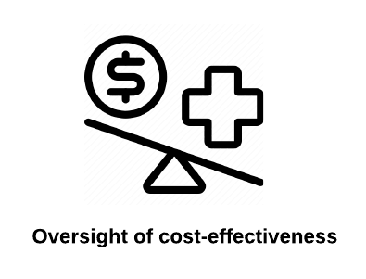
Methodological limitations of TPPs
Notes:
Several limitations underpinning the current TPP methodology were identified
TPPs rely solely on non-systematic searches of the literature and consultations with experts as main sources for test specifications. This is likely to introduce bias and subjectivity in terms of the evidence used to underpin test characteristic recommendations.
There was also a lack of transparency in terms of the methods used to develop the TPPs. For example, few TPPs reported how the expert selection process took place and which literature TPPs were based on. This, in turn, hinder the quality and credibility of sources on which TPPs are based.
TPPs mostly focus on the test analytical performance and clinical validity, whereas there was a lack of consideration as to how a test affects health-related outcomes for patients –namely test clinical utility
Finally, we noticed a complete oversight of cost-effectiveness considerations when defining the acceptable and desirable costs of new tests.

Slide 10
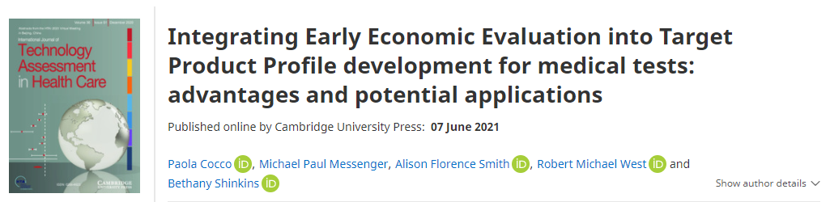
TPP methodology & Early Economic Evaluation
Early economic evaluation could be used to back-calculate in advance the necessary conditions for a test to be cost-effective
Notes:
Based on the limitations underpinning the TPP methodology, the main focus of my PhD has been to explore how and to which extend early economic evaluation could improve current TPP methodology. Early economic evaluation (EEE) and cost-effectiveness analysis are increasingly performed at the early development stages as a means of directing stop/go decisions and informing the optimal trajectory of future research.
Recently, we have published an opinion piece discussing the advantages and potential applications of integrating early economic evaluation into TPP development, alongside some areas for further improvement. Here we suggest that using EEE methods to inform TPPs provides a more objective, evidence-based and transparent approach to defining test specifications.

Slide 11
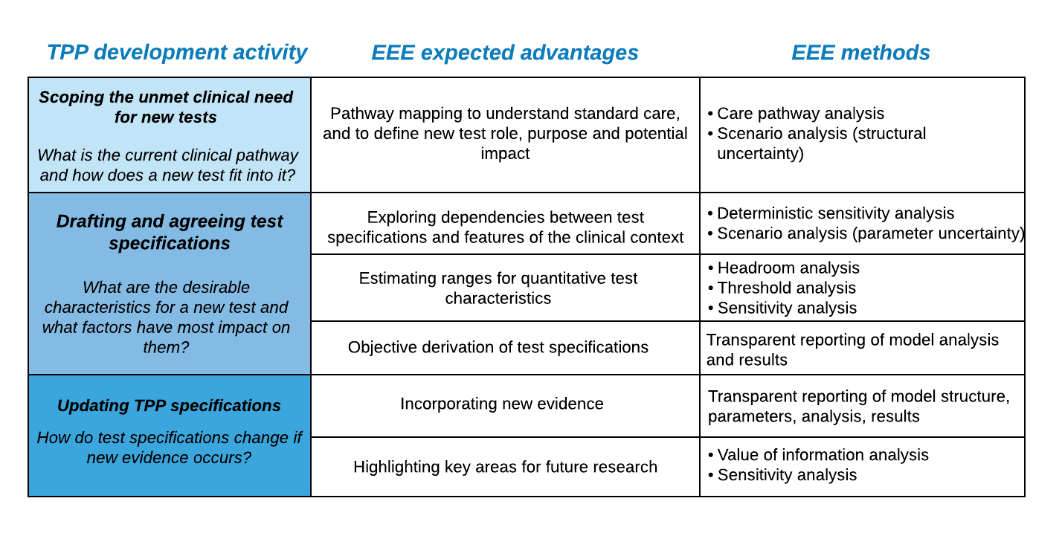
TPP methodology & Early Economic Evaluation
Notes:
This figure presents the possible advantages that early economic evaluation methods could afford across each of the four core activities of TPP development.
The scoping phase aims to define the focus of a TPP via literature review and meetings with stakeholders. It is unclear, however, if any formal pathway analysis is typically conducted.
We suggest that mapping the care pathway where new tests might sit will help
To identify key processes underpinning standard care
To understand how a new test might fit within an existing pathway, as well as its potential downstream consequences on clinical decision-making, patient workflow and economic outcomes
This, in turn, will help defining in advance test role, positioning, and which test characteristics to include in the early economic model.
Focusing on the drafting of a TPP, EEE might help to (i) explore dependencies between test specifications and features of the clinical context; (ii) facilitate optimization of quantitative test specifications based on a willingness-to-pay threshold; and (iii) increase the objectivity of data informing TPP requirements. I will now discuss each point separately.
Current TPP methodology specifies ‘desired’ and ‘acceptable’ level of performance for new tests, without investigating the relationship between different test characteristics. Early economic models, however, provide a framework by which the interdependency between different test characteristics (and features of the clinical context) can be explored and their impact on cost-effectiveness can be assessed.
In the absence of evidence for a new test, hypothetical values for test properties can be assigned and, for each specification or combinations of specifications, the downstream costs and benefits can be computed. Based on a specified WTP threshold, it is possible to back-calculate the maximum costs and minimum specifications for a new test to be cost-effective.
EEE methodology facilitates the generation of more objective data, which can be combined with subjective evidence to inform TPP specifications. EEE results can also support the elicitation of expert opinion, with clinical experts being asked to review and discuss the modelling findings.
Focusing on the last core activity, EEEs are sufficiently flexible to allow for the model to be updated as evidence is accrued.
During the remainder of this presentation, I will discuss how I have applied the EEE methodology to a case study example – a new point of care test for Clostridium difficile infection – to back-calculate necessary performance requirements new tests for CDI should possess based on cost-effectiveness considerations.

Slide 12

Case study – Clostridium difficile infection (CDI)
CDI is a health-care associated infection
Patients suspected with CDI are isolated in single rooms to prevent transmission
Slow time-to-diagnosis delays start of treatment and de-isolation of non-infective patients
A rapid POCT is being developed within a MRC-funded programme
Aim – to develop a model to identify the necessary properties for a hypothetical POCT for CDI to be cost-effective compared to standard care
Notes:
Clostridium difficile infection (CDI) is a common healthcare-associated infection with symptoms ranging from mild diarrhoea to colitis.
In the UK, patients with suspected CDI are typically isolated in single rooms while awaiting test results to prevent transmission, until confirmation of non-infectious diarrhoea
Slow time-to-diagnosis delays the administration of antibiotic treatment and hinders a quick de-isolation of non-infective patients.
New rapid tests are expected to help to optimise the hospital workflow via quicker time-to-diagnosis. A rapid point-of-care test is under development as part of a Medical Research Council-funded programme grant. To ensure that the test is ‘fit-for-purpose’, the aim of this model-based early economic evaluation was to identify the necessary properties for a hypothetical POCT for CDI to be cost-effective compared to standard care, from a UK NHS perspective. Specifically, the analysis focused to identify
The minimum diagnostic sensitivity and specificity of the test (i.e. the ability of a test to identify patients with and without the disease, respectively) – sorted by time-to-result values (i.e. the time required for a test to yield results)
The maximum cost for the test

Slide 13
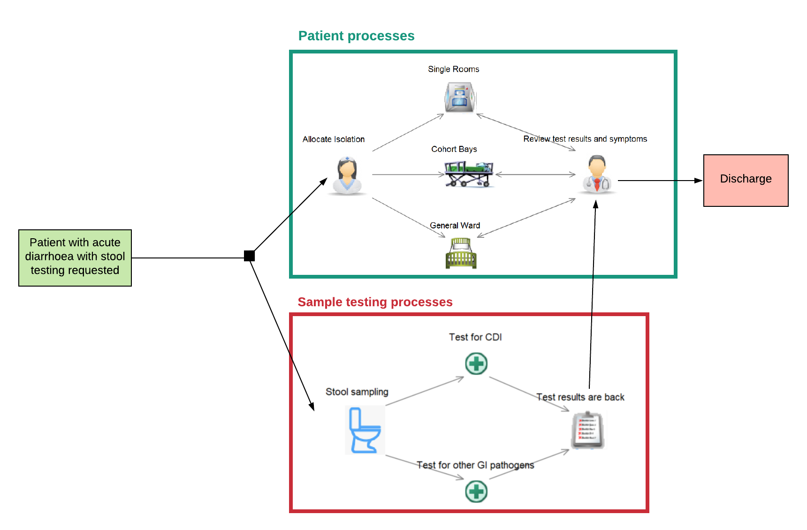
Discrete event simulation – model schematic
Notes:
I have then developed a discrete event simulation (DES) model in SIMUL8 to map the flow of patients presenting with CDI symptoms through the hospital setting. The model structure was built to reflect current clinical pathways in place at the Leeds Teaching Hospitals NHS Trust (LTHT). The model compares the hypothetical rapid test against the current two-step testing algorithm at LTHT – a combination of different tests run in a sequence
This slide gives you a simplified schematic of the model structure
In-hospital adult patients with acute diarrhoea for whom clinicians have requested stool testing enter the model. The upper branch of the model represents the movement of patients through the hospital, whereas the lower branch depicts the testing processes undertaken on each patient’s test samples.
Patients are moved into presumptive isolation, while their stool samples are tested for CDI and other gastrointestinal pathogens that might be causing diarrhoea. Suspected patients could be placed either in single rooms or general ward depending on current capacity constraints
Single rooms – only one patient can enter a single room with no potential of infecting others. If there is confirmation of infectious diarrhoea, patients remain in isolation until the end of their hospital length of stay
General ward – when no single rooms are available, patients remain in General ward while waiting for test result with a higher potential for infection transmission
Upon confirmation of infectious diarrhoea, positive CDI patients in General ward could be moved into single rooms (if available) or be grouped together into a cohort bay to reduce the risk of transmission.

Slide 14
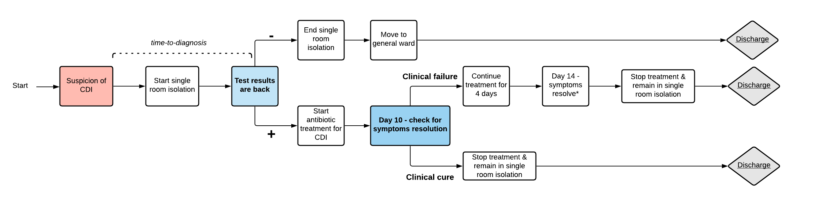
Discrete event simulation – LTHT clinical pathway
Notes:
This slide presents a schematic of the clinical pathway for patients suspected with CDI at LTHT
Upon suspicion of diarrhoea, patients start single room isolation while their stool samples are tested for CDI and other GI pathogens – as I’ve discussed in the previous slide.
Once test results are back, patients who tested negative end single room isolation (as they are confirmed as non-infectious) and they move to general ward until discharge.
In case of positive results for CDI, patients remain in single room isolation and start antibiotic treatment regimen for CDI for 10 days.
At day 10, clinicians check if confirmed CDI patients remain symptomatic (with diarrhoea). If symptoms resolve, this is considered a clinical cure. Patients no longer receive treatment but they remain in single room isolation until discharge as per LTHT clinical guidelines.
In case patients positive to CDI remain symptomatic, this is counted as a clinical failure. Patients therefore receive treatment for 4 additional days and after that symptoms are assumed to resolve. Upon symptoms resolution, patients no longer receive treatment and remain in single room isolation until discharge.

Slide 15
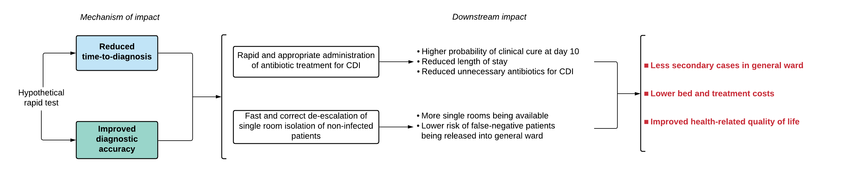
Discrete event simulation – impact of rapid test
Standard care at LTHT – two-stage testing algorithm – three tests run in a sequence
Diagnostic sensitivity – the ability of a test to correctly identify those with the disease
Diagnostic specificity – the ability of a test to correctly rule out those without the disease
Notes:
This model aims to capture two mechanisms via which the hypothetical rapid test (HT) might impact on clinical utility and cost-effectiveness outcomes, namely (1) reduced time-to-diagnosis, (2) improved diagnostic accuracy. These two mechanisms in turn (i) improve short-term clinical outcomes for confirmed CDI patients via a rapid and appropriate administration of antibiotic treatment for CDI (ii) support a fast and correct escalation of infection-control measures, to minimise in-hospital transmission and enable a rapid de-isolation of non-infected patients.
Early time-to-start treatment, via reduced time-to-diagnosis, increases the probability of clinical cure at day 10 of treatment, while also reducing the hospital length of stay compared with testing strategies with slower time-to-diagnosis. This, in turn, decreases the number of treatment days required for patients to recover to full health, and it also reduces the total treatment cost and bed cost per patient compared to standard care.
A HT with improved diagnostic sensitivity compared to standard care would reduce the number of missed cases for CDI. This, in turn, minimises the risk of false-negative patients being released into the general ward without receiving necessary CDI treatment. This, in turn, leads to fewer secondary cases within the general ward.
A HT associated with higher diagnostic specificity reduces the number of unnecessary antibiotic treatments for CDI, while also increasing the availability of free single rooms as non-infective patients are correctly de-isolated upon receipt of negative test results. With more single rooms being available, fewer patients are placed in the general ward – this minimises the infection spread within the general ward.

Slide 16

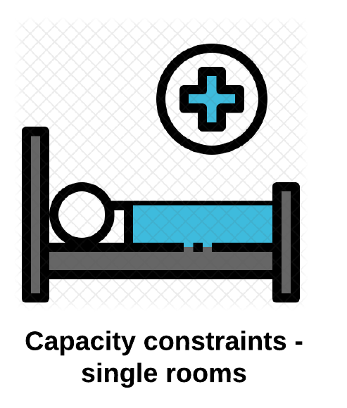


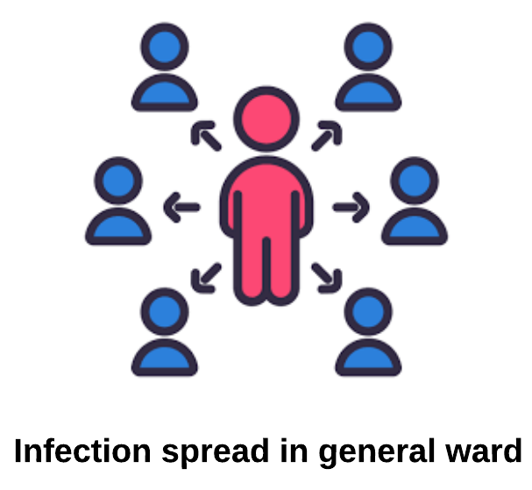
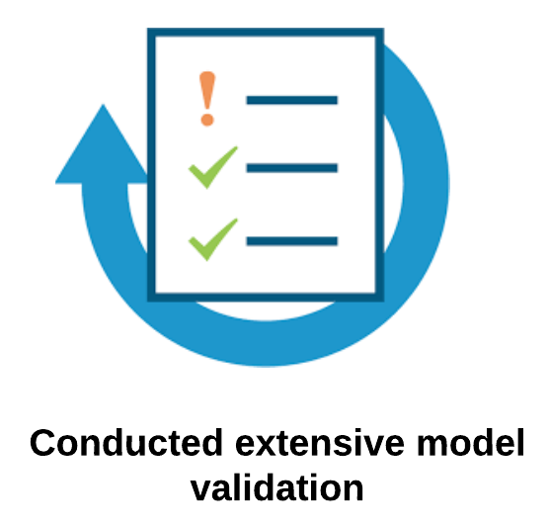
Discrete event simulation – model structure
Notes:
This slide shows you some key features of this DES model
To develop the conceptual structure of the model, I have mapped the clinical care pathway in place at LTHT via several consultations with clinical experts and a review of local clinical guidelines. Mapping the care pathway ensured that the key events of the clinical management for CDI patients were captured within the model structure, as well as the key processes underpinning the testing workflow (such as preparing the sample for testing, setting the machine).
The model captures the capacity constraints in place at LTHT – as single rooms are a scarce resource, it is important to assess whether a rapid diagnostic test could help to expedite the de-escalation of infection-control measures.
The model structure resembles as much as possible the dynamic bed allocation processes– for example, in case a patient within the general ward is confirmed with infectious diarrhoea, they may be transferred into a single room or a cohort bay depending on availability of single rooms to reduce risk of transmission.
Model parameters are taken from UK-based observational data on the clinical management of CDI patients, literature findings and expert opinion where necessary. Estimates of the impact of early diagnosis on short-term patient health outcomes are based on a prospective time-series study conducted in France.
The model also indirectly captures the infection spread within the hospital – depending on the number of confirmed patients without infection control measures, new secondary cases in general ward are estimated
I also conducted extensive model validation– consultations with clinical experts ensured the face validity of the conceptual model and its input data. The model was also checked for any errors in coding by running extreme values of parameters sets, replacing distributions with a constant number and tracking patient subgroups. Model coding also underwent external validation.

Slide 17
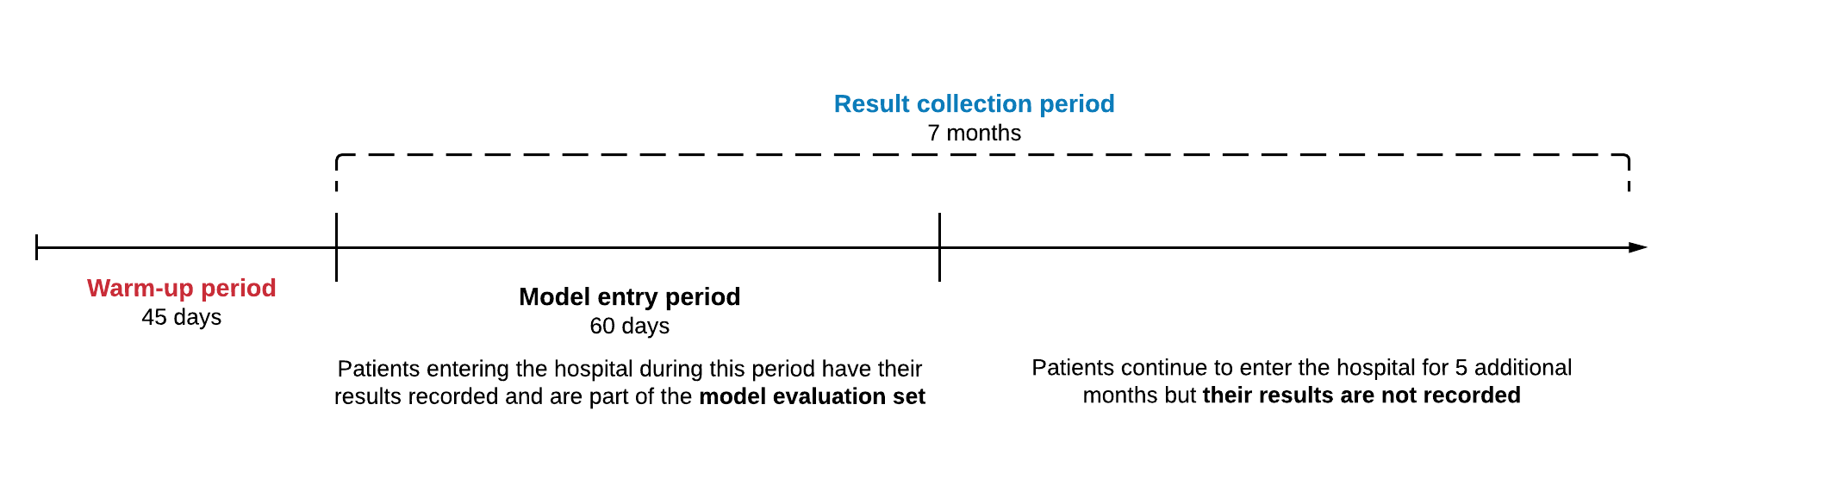
Discrete event simulation – model analysis
Analyses are based running 70 model replications (i.e. each replication using a different random number sequence)
A warm-up period is applied to initially populate the model
Model records results only for patients within the ‘model evaluation set’ (i.e. 60 days)
Cost-effectiveness is measured using NICE WTP threshold per QALY gained
Notes:
Analyses are based running seventy model replications, meaning running the model 70 times, with each run using a different random number sequence. This reduces the possibility of ‘first-order’ uncertainty – when identical patients do not get the same outcomes because of different random numbers being drawn from probability distributions.
For each model replication, a warm-up period of 45 days was applied to initially populate the hospital system, and to simulate the capacity constraints patients face once they enter a busy hospital. Starting with the model ‘cold’ – meaning having all single rooms available – would overestimate the availability of single rooms.
Upon completion of the warm-up period, each model replication runs for a total of 7 months. The model, however, does not record outcomes for every patient within 7 months, but only for the patients entering the hospital during the model entry period – which is set equal to 60-days (two months) following the end of the warm-up period. This ensures that every patient within the model evaluation set can have their full experience of the clinical pathway simulated
Model results are expressed in terms of incremental net monetary benefits comparing hypothetical test strategy (HT) against standard care, using the NICE WTP threshold per quality-adjusted life years (QALY) gained.

Slide 18
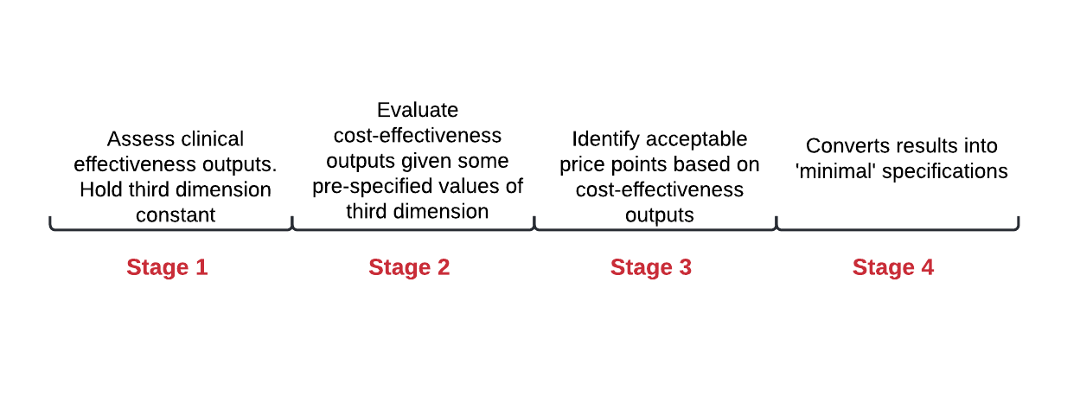
Discrete event simulation – model analysis
Four-stage pragmatic approach to identify the expected minimum performance benchmarks
Notes:
While evaluating the performance of a hypothetical test, high uncertainty is unavoidable. I then developed and applied a four-step pragmatic approach to define the minimum test performance benchmarks.
Stage 1 focuses on assessment of clinical effectiveness outputs to rule out any combinations of diagnostic accuracy that result in the HT strategy being clinically less effective than the standard care given a rapid time-to-result.
Stage 2 evaluates the cost-effectiveness of HT assuming zero testing cost for HT, sorted by certain pre-specified time-to-result values. The aim was to rule out performance levels where the HT was expected to be less cost-effective than standard care, despite the test itself being costed at zero.
Stage 3 focuses on identifying acceptable price points for the test based on cost-effectiveness outputs. A headroom and a threshold analysis were conducted using the NICE WTP threshold per QALY gained.
Stage 4 converts the results of the previous stages into ‘acceptable’ specifications.
In the next slides I will present the results for each of these stages.

Slide 19
1 – Assessment of clinical effectiveness
Assumption– HT is less clinically effective than standard care when (i) it yields negative incremental QALY gains AND (ii) it leads to more secondary cases
HT POCT strategy
 |  | Diagnostic specificity
 |  | 100% |  | 98% |  | 96% |  | 94%
 |  | ΔQALY | Secondary cases prevented | ΔQALY | Secondary cases prevented | ΔQALY | Secondary cases prevented | ΔQALY | Secondary cases prevented
Diagnostic sensitivity | 100% | 0.469 | 12 | 0.314 | 6 | 0.136 | -1 | -0.007 | -7
 | 98% | 0.399 | 11 | 0.247 | 5 | 0.076 | -2 | -0.065 | -8
 | 96% | 0.337 | 10 | 0.183 | 4 | 0.021 | -3 | -0.125 | -9
 | 94% | 0.269 | 9 | 0.117 | 3 | -0.049 | -4 | -0.192 | -9
 | 92% | 0.205 | 7 | 0.049 | 1 | -0.108 | -5 | -0.252 | -10
 | 90% | 0.145 | 6 | -0.005 | 0 | -0.161 | -6 | -0.306 | -11
 | 88% | 0.078 | 5 | -0.077 | -1 | -0.236 | -7 | -0.382 | -13
 | 86% | 0.006 | 4 | -0.140 | -2 | -0.299 | -8 | -0.435 | -13
 | 84% | -0.063 | 2 | -0.206 | -3 | -0.359 | -9 | -0.501 | -14
 | 82% | -0.129 | 1 | -0.266 | -4 | -0.417 | -10 | -0.564 | -16
 | 80% | -0.191 | -1 | -0.332 | -6 | -0.473 | -11 | -0.625 | -17
 | 70% | -0.519 | -8 | -0.641 | -12 | -0.783 | -17 | -0.921 | -22
 | 50% | -1.194 | -24 | -1.280 | -26 | -1.391 | -29 | -1.518 | -33
15 min time-to-result (best case value)
Values in bold format represent the sensitivity specificity pairs at which HT yields higher QALY gains and leads to more secondary infections being prevented
Values in italic format represent the sensitivity specificity pairs at which HT yields lower QALY gains but leads to less secondary infections
Notes:
The aim of this stage is to identify the region of diagnostic sensitivity and specificity where HT is expected to be less clinically effective than standard care.
HT is assumed to be less clinically effective when two conditions are met (1) when it yields negative incremental QALY gains and (2) when it leads to more secondary cases compared to standard care. The choice of which clinical outcomes to assess, however, should be discussed upfront with clinical experts during the scoping phase.
I have then conducted a two-way sensitivity analysis varying diagnostic sensitivity and specificity values. At this stage I’ve kept the third performance dimension, time-to-result, constant at 15 minutes as best case value.
Results from the two-way sensitivity analysis are presented in this figure. Each combination of diagnostic sensitivity and specificity is associated with a colour, with higher values of incremental QALYs, more secondary infections prevented associated with greener colourings.
Lower values of incremental QALYs, less secondary infections prevented are associated with redder colourings. The region of diagnostic accuracy where HT is expected to be clinically effective at 15 minutes is highlighted by a bold black line.
The lower the diagnostic specificity, the higher the minimal required sensitivity for HT to yield a positive clinical benefit. At perfect specificity, the minimal sensitivity is 82%, whereas at 98% specificity – the required minimal sensitivity jumps at 90%. When specificity is set to 96%, the minimal sensitivity is 96%. HT is not expected to be clinically effective at any value of sensitivity when specificity is equal to 94%.

Slide 20
2 – Assessment of cost-effectiveness outputs - results
 |  | Diagnostic specificity
 |  | 100% |  |  | 98% |  |  | 96% |  |  | 94%
Time-to-result |  | 15 min | 90 min | 180 min | 15 min | 90 min | 180 min | 15 min | 90 min | 180 min | 15 min | 90 min | 180 min
Diagnostic sensitivity | 100% | 599909 | 577982 | 535076 | 369939 | 319596 | 303845 | 106146 | 90087 | 49603 | -89098 | -109808 | -173145
 | 98% | 542445 | 514831 | 485013 | 326192 | 289570 | 271645 | 73285 | 47207 | 9380 | -127772 | -151550 | -205195
 | 96% | 505136 | 496729 | 453465 | 286989 | 243111 | 228143 | 48042 | 3652 | -18645 | -162581 | -182459 | -247693
 | 94% | 468668 | 449998 | 410489 | 252306 | 214197 | 183851 | 3075 | -36668 | -49023 | -197231 | -227418 | -274410
 | 92% | 422843 | 392997 | 380708 | 194617 | 169993 | 147554 | -35615 | -68601 | -92634 | -236021 | -271246 | -309673
 | 90% | 377578 | 362764 | 339100 | 162391 | 134103 | 111918 | -69659 | -103348 | -128604 | -265681 | -301392 | -334807
 | 88% | 344772 | 321287 | 312854 | 120459 | 89531 | 83482 | -112850 | -145998 | -165433 | -312303 | -345569 | -374212
 | 86% | 293759 | 273130 | 268902 | 81951 | 49682 | 47261 | -146585 | -183775 | -192265 | -336201 | -359871 | -401980
 | 84% | 247124 | 235436 | 219646 | 36798 | 9792 | 1202 | -176460 | -211350 | -236039 | -379013 | -410101 | -447815
 | 82% | 196151 | 187982 | 170778 | -1929 | -20368 | -36192 | -213339 | -243500 | -269093 | -421928 | -444554 | -488917
 | 80% | 148064 | 136764 | 118292 | -53680 | -72991 | -75712 | -248844 | -272690 | -313064 | -462447 | -484966 | -528367
 | 78% | 99948 | 91301 | 69132 | -95546 | -112240 | -117551 | -294950 | -318647 | -335508 | -499752 | -519600 | -568055
 | 76% | 61877 | 58605 | 30771 | -130577 | -148991 | -158139 | -322687 | -348187 | -365926 | -527561 | -548657 | -579857
 | 74% | 440 | -14399 | -19631 | -181965 | -188602 | -204454 | -368823 | -385869 | -420152 | -572021 | -595850 | -623839
 | 72% | -39744 | -34959 | -58043 | -210796 | -224839 | -233551 | -411857 | -429704 | -453100 | -596384 | -608997 | -646240
WTP £20,000 per QALY gained
Each combination of performance specifications is associated with a colour, with higher of INMB associated with greener colourings. Lower values of INMB are associated with redder colourings.
Vary the diagnostic accuracy pairs identified in the previous stage sorted by time-to-result value
 |  | Diagnostic specificity
 |  | 100% |  |  | 98% |  |  | 96%
Time-to-result |  | 15 min | 90 min | 180 min | 15 min | 90 min | 180 min | 15 min | 90 min | 180 min
Diagnostic sensitivity | 100% | 599909 | 577982 | 535076 | 369939 | 319596 | 303845 | 106146 | 90087 | 49603
 | 98% | 542445 | 514831 | 485013 | 326192 | 289570 | 271645 | 73285 | 47207 | 9380
 | 96% | 505136 | 496729 | 453465 | 286989 | 243111 | 228143 | 48042 | 3652 | -18645
 | 94% | 468668 | 449998 | 410489 | 252306 | 214197 | 183851 | 3075 | -36668 | -49023
 | 92% | 422843 | 392997 | 380708 | 194617 | 169993 | 147554 | -35615 | -68601 | -92634
 | 90% | 377578 | 362764 | 339100 | 162391 | 134103 | 111918 | -69659 | -103348 | -128604
 | 88% | 344772 | 321287 | 312854 | 120459 | 89531 | 83482 | -112850 | -145998 | -165433
 | 86% | 293759 | 273130 | 268902 | 81951 | 49682 | 47261 | -146585 | -183775 | -192265
 | 84% | 247124 | 235436 | 219646 | 36798 | 9792 | 1202 | -176460 | -211350 | -236039
 | 82% | 196151 | 187982 | 170778 | -1929 | -20368 | -36192 | -213339 | -243500 | -269093
WTP £20,000 per QALY gained
Each combination of performance specifications is associated with a colour, with higher of INMB associated with greener colourings. Lower values of INMB are associated with redder colourings.
Values in bold format represent the sensitivity specificity pairs at which HT yields higher QALY gains and leads to more secondary infections being prevented
Values in italic format represent the sensitivity specificity pairs at which HT yields lower QALY gains but leads to less secondary infections
Notes:
The acceptable combinations of diagnostic accuracy as identified in the previous stage are varied to assess their joint impact on cost-effectiveness, sorted by time-to-result values = 15 minutes (considered the fastest time-to-result for POCT in this context), 90 minutes ( as a midpoint value) and 180 minutes (equal to time-to-result for laboratory-based PCR). At this stage the unit cost for the HT is assumed to be null.
This table presents the INMB at WTP £20,000 per QALY gained comparing HT against standard care testing strategy– sorted by time-to-result value. Similarly to the previous slide, diagnostic accuracy pairs with higher INMB are associated with greener colourings, whereas performance specifications with lower (and negative) INMB than standard care are associated with redder colourings.
The longer the time-to-diagnosis, the higher the minimal sensitivity and specificity for HT to be more cost-effective than standard care. Focusing on the INMB at perfect conditions (namely perfect diagnostic accuracy), the maximum INMB decreases the longer it takes to receive test results . At 98% specificity, the minimal required sensitivity for HT to be clinically and cost-effective is equal to 90% at 15, 92% at 90 and 180 min. When specificity is set equal to 96%,, the minimal required sensitivity jumps at 96% at 15 min and 98% at 90 and 180 min.
Results show that the region of diagnostic sensitivity and specificity where HT is expected to be more clinically and cost-effective reduces the longer the time-to-diagnosis.

Slide 21
3 – Headroom and threshold costs
 |  | Diagnostic specificity
 |  | 100% |  |  | 98% |  |  | 96%
Time-to-result |  | 15 min | 90 min | 180 min | 15 min | 90 min | 180 min | 15 min | 90 min | 180 min
Diagnostic sensitivity | 100% | £554 | £534 | £494 | £342 | £295 | £281 | £98 | £83 | £46
 | 98% | £501 | £476 | £448 | £301 | £268 | £251 | £68 | £44 | £9
 | 96% | £467 | £459 | £419 | £265 | £225 | £211 | £44 | £3 | -£17
 | 94% | £433 | £416 | £379 | £233 | £198 | £170 | £3 | -£34 | -£45
 | 92% | £391 | £363 | £352 | £180 | £157 | £136 | -£33 | -£63 | -£86
 | 90% | £349 | £335 | £313 | £150 | £124 | £103 | -£64 | -£96 | -£119
 | 88% | £319 | £297 | £289 | £111 | £83 | £77 | -£104 | -£135 | -£153
 | 86% | £271 | £252 | £248 | £76 | £46 | £44 | -£135 | -£170 | -£178
 | 84% | £228 | £218 | £203 | £34 | £9 | £1 | -£163 | -£195 | -£218
 | 82% | £181 | £174 | £158 | -£2 | -£19 | -£33 | -£197 | -£225 | -£249
WTP £20,000 per QALY gained
Each combination of performance specifications is associated with a colour, with higher values of threshold costs associated with greener colourings. Lower values of threshold costs are associated with yellower colourings.
Black cells represents values where (1) HT is not clinically effective or (2) a negative unit cost would be required for HT being more cost-effective
Notes:
The third stage aims to define the headroom cost (meaning the maximum cost at which HT is expected to be cost-effective given perfect diagnostic accuracy) and the threshold costs – namely the maximum cost at which HT can be priced and still be cost-effective given the lowest acceptable conditions.
At 15 minutes, HT can be priced up to 554£ assuming perfect diagnostic accuracy and still be cost-effective at a WTP threshold of £20,000 per QALY gained. When diagnostic sensitivity and specificity were reduced to their minimal level as identified in the previous stages (namely 96% sensitivity and 96% specificity), a maximum cost for HT to be cost-effective is approximately 44£.
The longer the time-to-diagnosis, the lower the headroom and threshold costs for HT following a reduction in the INMB as presented in the previous 2 stages. With a time-to-result of 90 and 180 minutes time-to-result, the headroom cost for a perfectly accurate HT appears to be lower than the headroom cost at 15 min. At the lowest acceptable sensitivity of 98% and specificity of 96%, the threshold cost would be £44 and £9 at 90 and 180 minutes, respectively.
This table shows that the shorter the time-to-diagnosis, the higher the maximum price developers can asks for a new CDI test. The longer the time-to-diagnosis, the lower the cost for the test to maintain cost-effectiveness while a higher minimal diagnostic accuracy is required to maintain clinical effectiveness.

Slide 22
4 – Minimal and optimal performance specifications
Minimal specifications – lowest value of sensitivity and specificity which maintained positive clinical benefit and cost-effectiveness
Optimal specifications – sensitivity and specificity pair which yielded the highest clinical benefit
Notes:
Based on the results for the previous stages, this table describes the minimal and optimal performance requirements which result in HT being more clinically and cost-effectiveness – sorted by time-to-result values.
Minimal values of diagnostic sensitivity and specificity are defined as the lowest pair of diagnostic accuracy which maintained a positive clinical benefit and cost-effectiveness. Optimal values of diagnostic accuracy are defined as the sensitivity and specificity pair which yields the highest clinical benefit. This is usually 100%, as a test cannot exceed 100% sensitivity or specificity.
At 15 minutes, the lowest minimally acceptable diagnostic sensitivity and specificity were both 96%. If we consider the results at 15 minutes as a base case scenario, the lowest minimal sensitivity and specificity which maintain clinical and cost-effectiveness increases the longer it takes to get test results back. For instance, assuming a time-to-result of 90 and 180 minutes, the minimal sensitivity is equal to 98%, whereas the minimal specificity remains 96%. This means that a test with slower time-to-diagnosis requires a higher sensitivity to maintain a positive clinical benefit and cost-effectiveness, while holding constant a minimal specificity at 96%.
With a prolonged time-to-result, the maximum price at which test developers can charge for a perfectly accurate test decreases – as discussed in the previous slide.

Slide 23
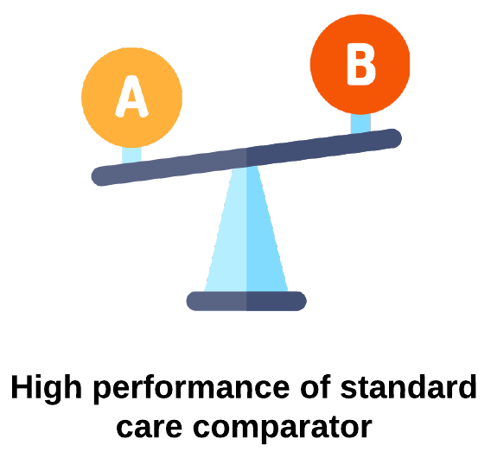
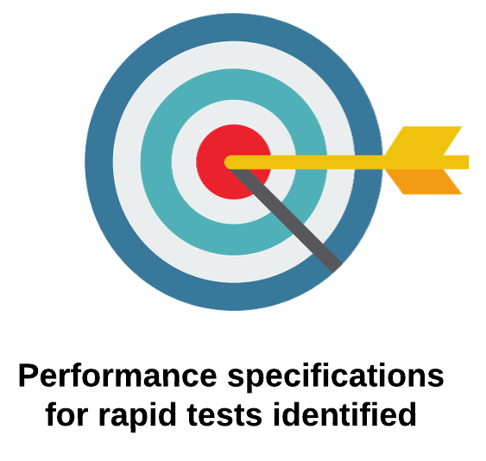

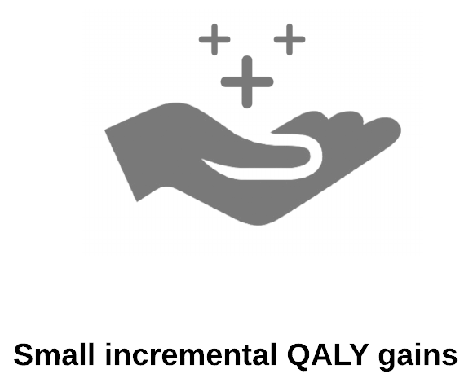
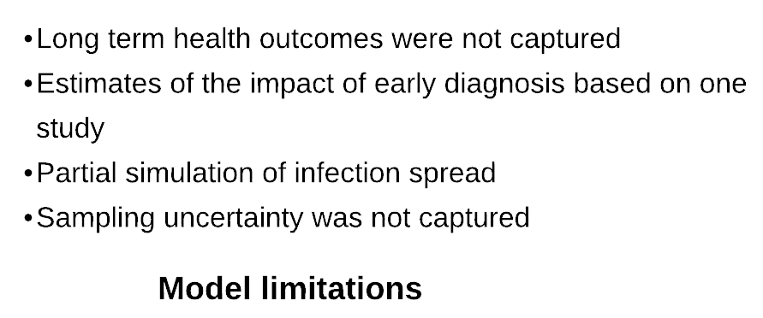
Discrete event simulation - discussion
Notes:
Model results helped to identify in advance some performance specifications developers should aim to achieve while developing new rapid tests for CDI diagnostics.
Based on the model results, diagnostic specificity appears to be a greater driver of clinical utility and cost-effectiveness than diagnostic sensitivity. Because of the low prevalence of CDI, incorrectly diagnosing a proportion of healthy patients as CDI positive has a greater impact than missing few truly positive CDI patients. At the moment I am exploring the impact of having a higher disease prevalence on the minimal acceptable performance requirements.
Minimal requirements for HT to be more clinically and economically effective than standard care appeared to be high – this is mostly due to the high performance of the standard care comparator – running a two stage testing algorithm is considered a cost-effective option for CDI as only positive patients fully undergo the testing pathway. This model is flexible enough to explore the impact of having a less effective or efficient baseline diagnostic pathway as a comparator on the minimal performance requirements.
Small incremental QALY gains between testing strategies were observed – this is a common feature among economic evaluation of diagnostic tests given that the impact tests have on patient health is usually mediated through treatment effective. The model also presents some limitations
The long-term consequences of treatment were not captured in the model due to paucity of data on the impact that early diagnosis, and hence early treatment, might have on patient survival or long-term quality of life
Estimates of the impact of early diagnosis on short term patient outcomes are based on only one study. More evidence on the impact of rapid diagnosis on the clinical management of CDI patients is thereby required.
This model also partially simulates the infection spread within general ward and most importantly does not capture sampling uncertainty as no probabilistic sensitivity analysis was conducted

Slide 24

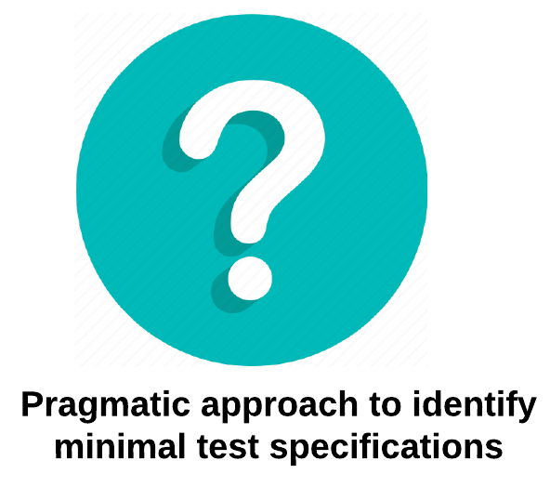

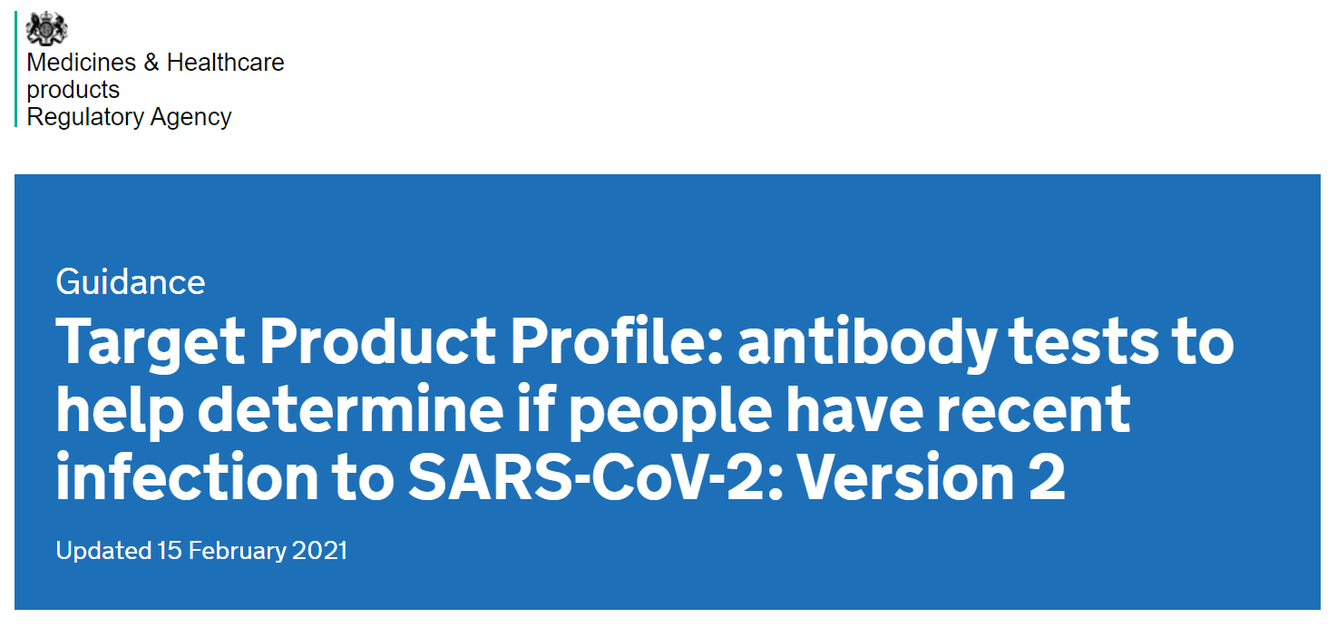
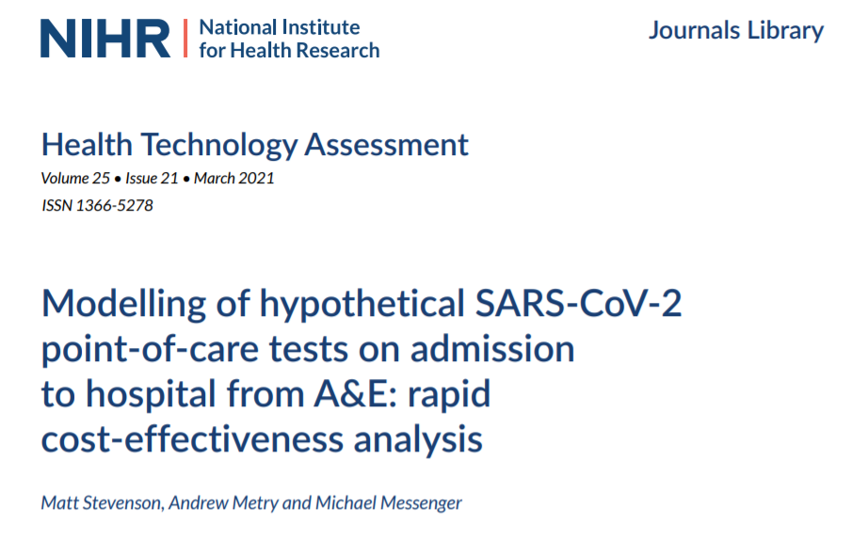

EEE & TPP methodology – key considerations
Notes:
Finally, I will briefly present some key aspects to consider when integrating early economic evaluation methods into TPP development.
While defining the desirable properties for a hypothetical test, high uncertainty is unavoidable - tests specifications might vary when considering different aspects underlying either the test itself or the care pathway. I decided for a pragmatic approach, based on a series of sensitivity analyses to handle three key performance dimensions simultaneously. I am currently working on formalising further this approach so that it could be used for other clinical contexts.
This pragmatic approach could be expanded to inform additional aspects of the TPP – such as analytical performance requirements (e.g. maximum bias and imprecision of the test), human factors, infrastructural requirements
Regardless of the number of parameters addressed, modelling results should always be presented to clinical experts and relevant stakeholders in the TPP process. This ensures that the final benchmarks of performance listed within TPPs are based on agreed consensus amongst appropriate parties. Rather than replacing other data sources within TPP development, modelling results in this context should be regarded as a means to inform and support a group consensus.
In the systematic review of TPPs methodology I have presented earlier, we found that none of the TPPs being reviewed employed EEE methodology. More recently however, an early economic model of COVID-19 POCTs was published as part of a NICE-commissioned project. This model aimed to assess the costs and benefits of having a hypothetical COVID-19 POCT which met the performance specifications for diagnostic accuracy and time-to-result presented in a TPP issued by the UK MHRA. This use of EEE represents a major shift in TPP methodology, and is expected to pave the way for similar studies in the future. More case studies and applications are needed, especially non-infectious diseases case studies as the only two EEEs in this context are both on diagnostics for infectious diseases.

Slide 25


Acknowledgements
Funding: ‘Antimicrobial Resistance Cross Council Initiative’ (MR/N029976/1)
Supervisory team: Bethany Shinkins, Alison Smith, Kerrie Davies, Robert West
Notes:
Thank you for your attention. I would like to acknowledge my funders and my PhD supervisors. My PhD scholarship was funded by a MRC grant aiming to develop rapid diagnostics to reduce the burden of antimicrobial resistance. My supervisors are Beth Shinkins, Alison Smith, Kerrie Davies and Robert West.

Slide 26


Thanks for your attention!
P.Cocco@leeds.ac.uk
@paola__cocco

